Slide 1
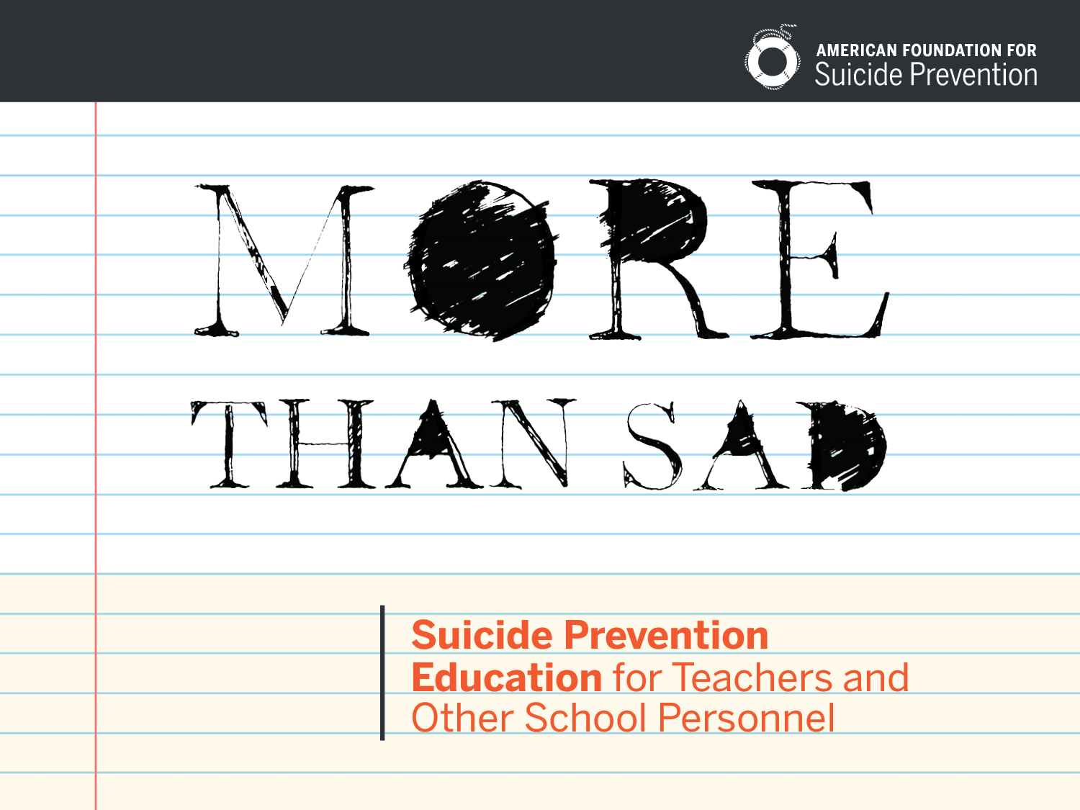
Notes:
Facilitator tips:
Introduce yourself. If you are connected with your local AFSP Chapter, share what role you play with AFSP (Walk Chair, Board Member, Volunteer, etc.)
Thank your participants for coming.
Mention that this program is on the national best practices registry. (for more information on this, visit: http://www.sprc.org/bpr/section-III/more-sad-suicide-prevention-education-teachers-and-other-school-personnel
DO NOT SHARE YOUR PERSONAL ATTEMPT OR LOSS STORY AT THIS TIME. SAVE IT FOR THE THANK YOU SLIDE.
Example: “Good afternoon! My name is Shelby Rowe and I’m the President of the Arkansas Chapter for the American Foundation for Suicide Prevention. Thank you for joining us for More Than Sad: Suicide Prevention Education for Teachers and Other School Personnel.” Created in 2007, More Than Sad is recognized as an effective, evidence-based training program and adheres to both statewide and national standards for suicide prevention training programs for educators. In our state, More Than Sad is one of only a handful of programs approved by the Arkansas Department of Education to meet the requirements set forth by the Jason Flatt Act of 2012, which requires all educators to complete at least 2 hours of professional development in suicide prevention every 5 years.”

Slide 2
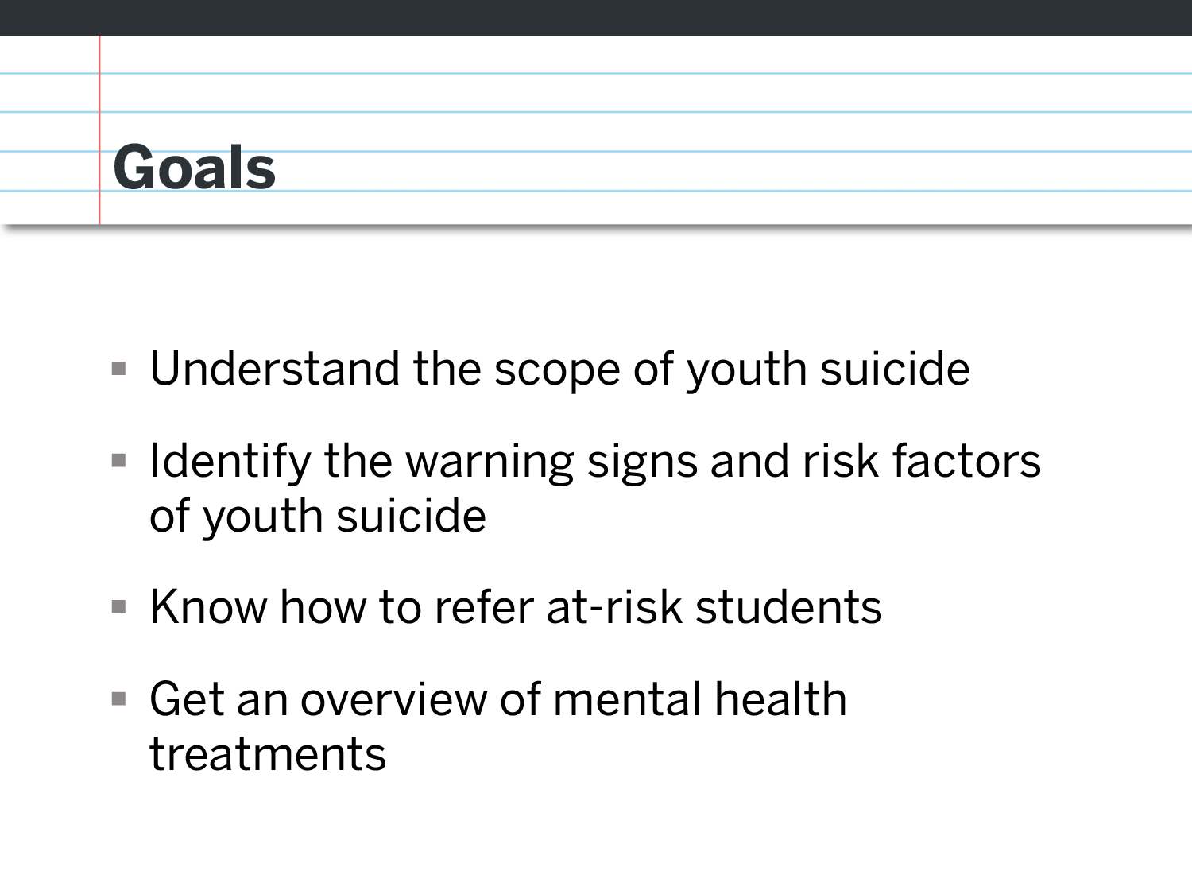
Notes:
“In today’s presentation, we’re going to look at the scope of youth suicide. We’re going to learn how to identify common warning signs and risk factors for suicide, as well as review tips for referring at risk students. We’re also going to briefly overview what mental health treatments for teens might look like.”
Facilitator’s note : Participants can follow along in the manual as you highlight the main points of each section. Encourage them to jot any additional information you will provide in the margins. Make copies of the program manual, but do not give participants copies of your slides. You may want to give them a state and/or national fact sheet as well.

Slide 3
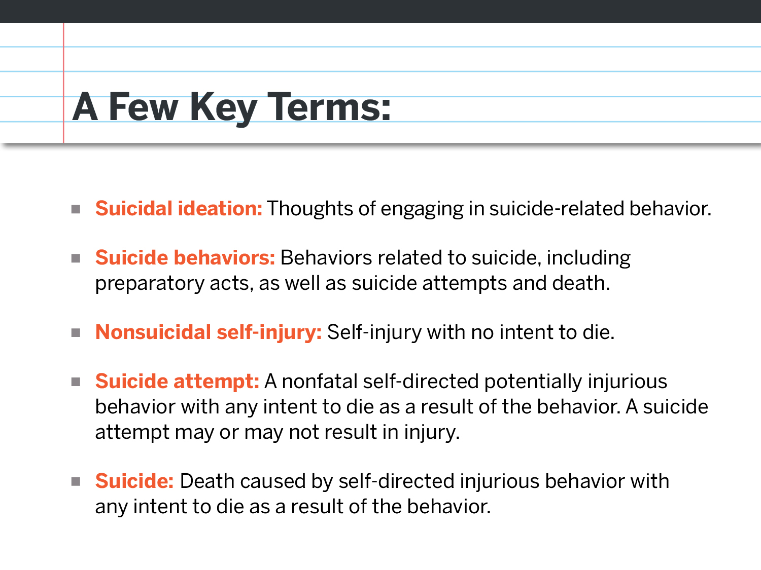
Notes:
Before we get started, let’s go over some key terms:
When you hear the term “Suicide Ideation”, it simply refers to any thoughts of suicide
Ideation can be expressed as Suicide behaviors, which refer to any acts or behaviors that leading up to a suicide attempt.
Not all self-injurious acts are suicidal behaviors. Non-suicidal self-injury refers to self-injurious acts with no intent to die. For example, with a show of hands, how many of you have either pierced ears or maybe a tattoo? These are self-injurious acts, however there is not an intent to die.
On the other hand, when someone makes a suicide attempt, there is an intent to die. These attempts may or may not result in physical injury, but the intent to die was present.
And finally, a suicide is defined as a self-directed injurious behavior with the intent to die that results in death.

Slide 4
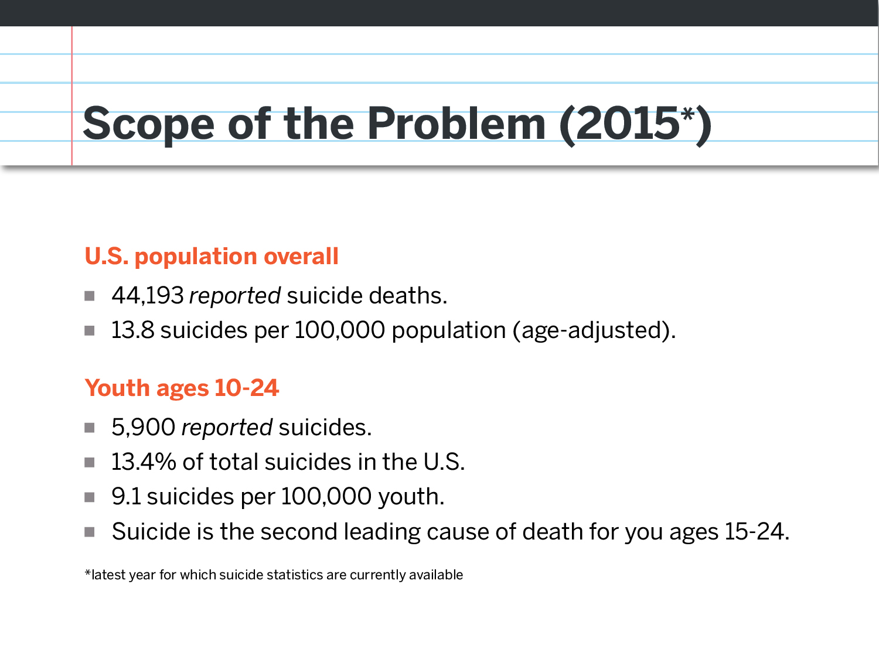
Notes:
According to the death statistics collected and compiled by the CDC from the year 2013, 41,149 Americans were reported to have died by suicide.
Suicides in this country occur at a rate of 13.0 per 100,000.
Males make up nearly 78% of all deaths by suicide in this country.
Over half, or 51.5% of all reported suicides were by firearm.
I want to stress the word reported because suicide has been historically under-reported. There are many reasons why this is the case. Sometimes the stigma surrounding suicide makes families hesitant to classify death as a suicide. The cause of death can also be difficult for a coroner to determine. Only two or three out of ten people who die by suicide leave a note.

Slide 5
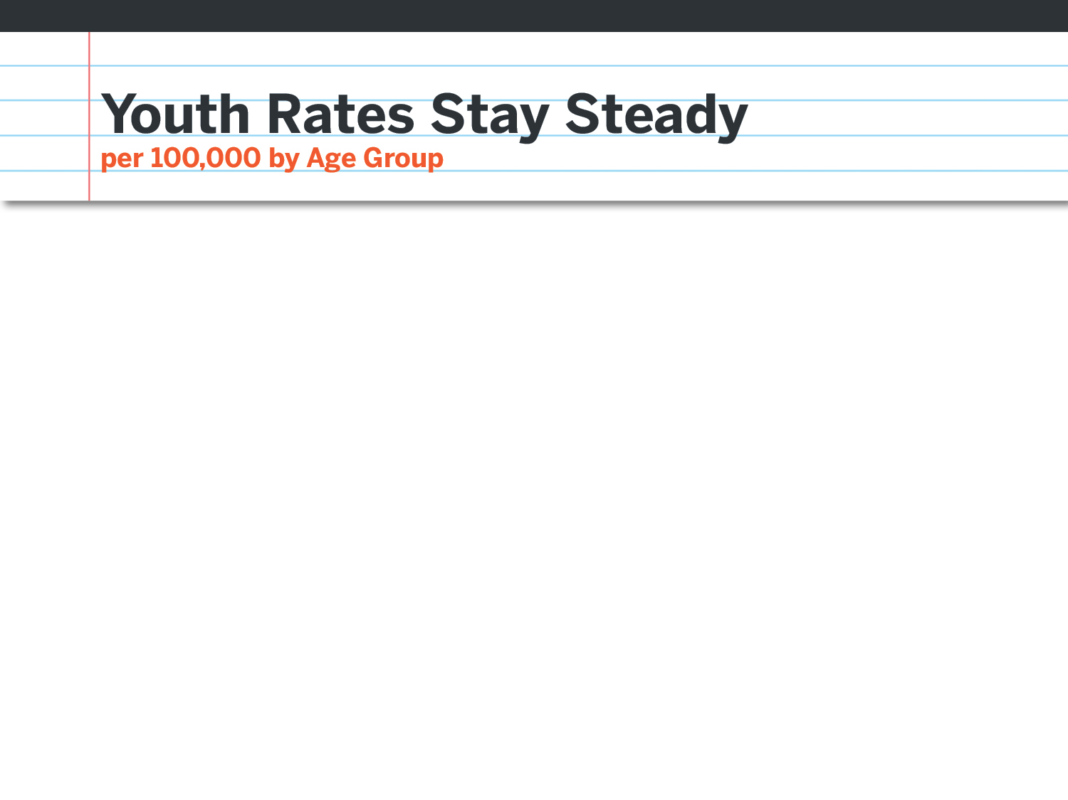
Notes:
Rates for young people have remained relatively stable over the past several years. Notice that although there has been a slight increase for individuals under 20 since 2001, it reflects a change of no more than 1 additional death per population of 100,000.
You’ll see in purple that the age group that has seen the most dramatic increase is for Americans ages 45-64.

Slide 6
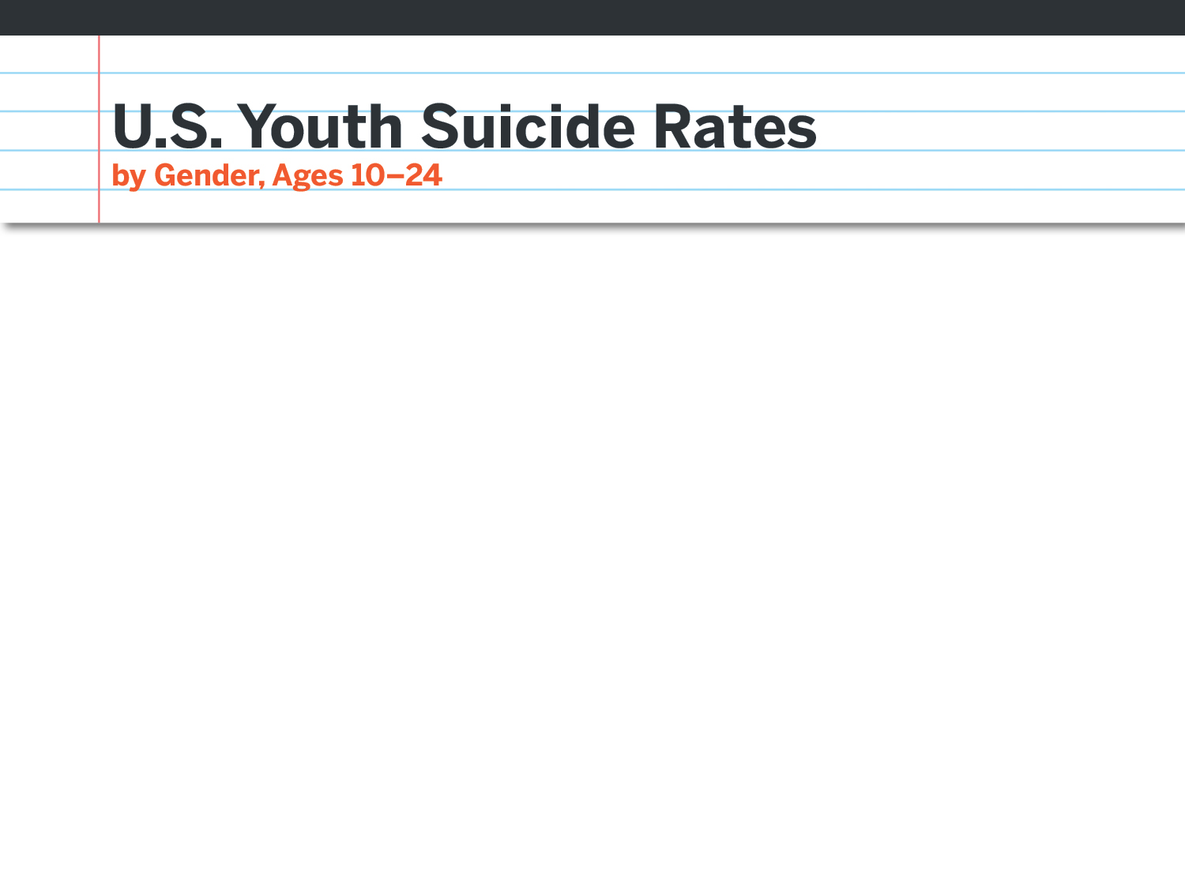
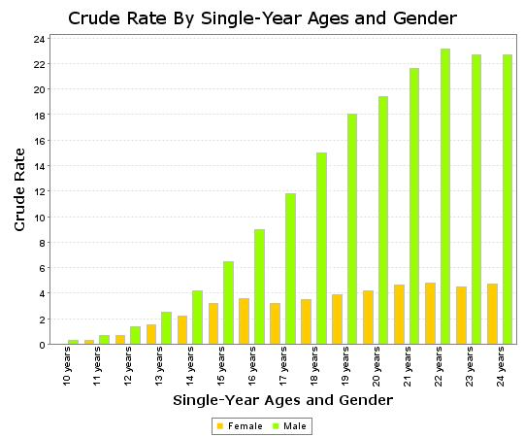
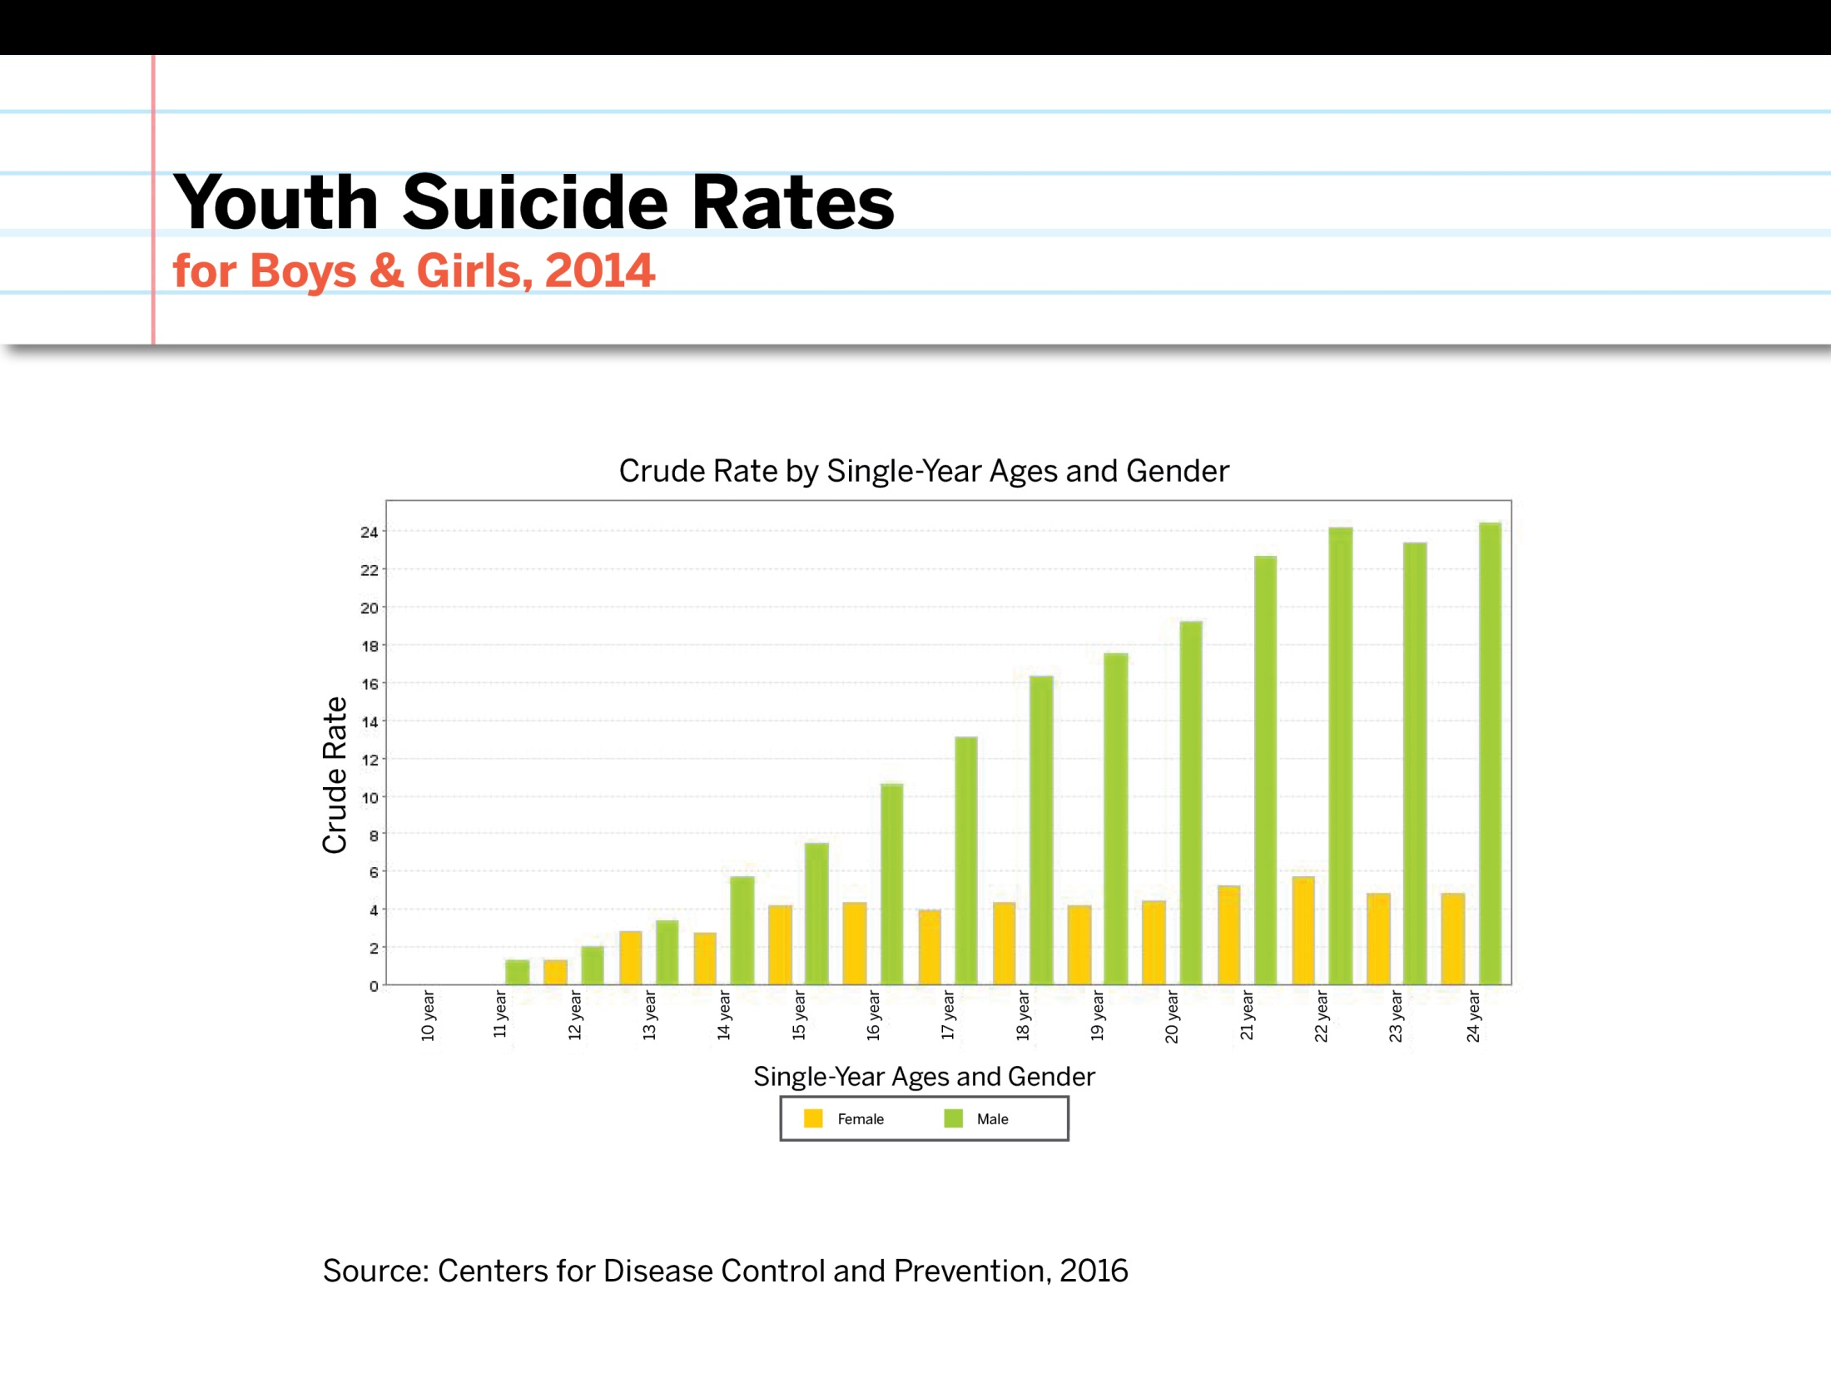
Gender Differences in Suicide Rates
Notes:
This graph shows a comparison between suicide rates for males between the ages of 10 and 24 – the blue line - and those for females in the same age range, shown in red.
At age 12, we can see that there is little difference between the suicide rate for boys and girls. By age 18, however, the boys’ rate is 5 times higher than the girls’ rate (15 suicides per 100,000 boys vs. 3 per 100,000 girls). This difference between the sexes remains through young adulthood, peaking at age 22, when the male suicide rate is more than 6 times the female rate.
Why the difference between gender? Some common reasons include:
It’s more culturally acceptable for girls to seek help.
Gender differences in traits like aggression and impulsivity are thought to contribute to the higher rate of suicide in males across all ages.
Boys typically have more access to lethal means such as firearms.

Slide 7
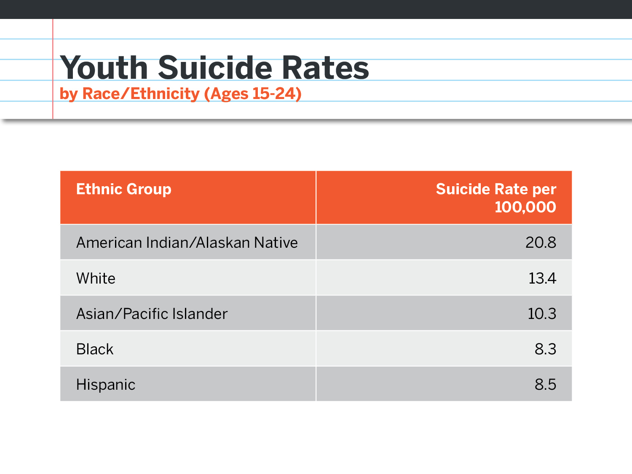
Notes:
When we look at youth suicide rates by ethnicity for 2015, White and American Indian youth have a suicide rate above the national rate for this age group of 12.5 per 100,000.

Slide 8
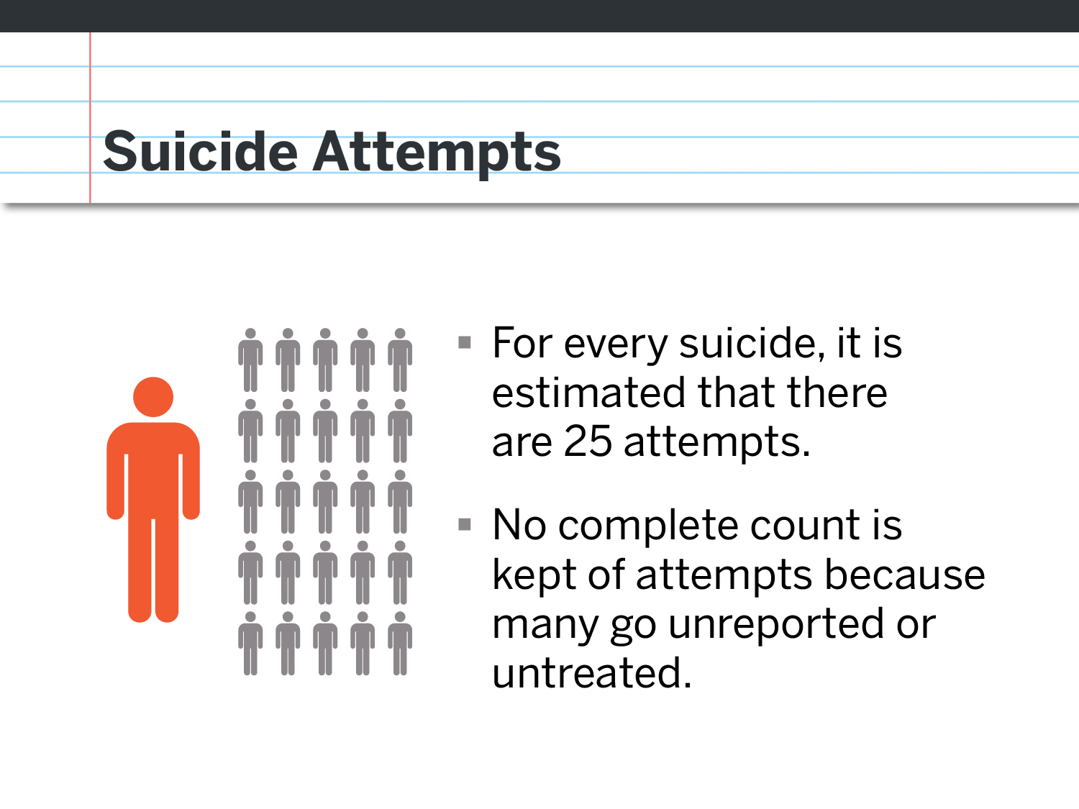
Notes:
The CDC gathers hospital admission data for non-fatal injuries. We only have data for individuals who are admitted into medical hospitals for self-inflicted injuries so this number is very conservative because many suicide attempts do not require medical attention.

Slide 9
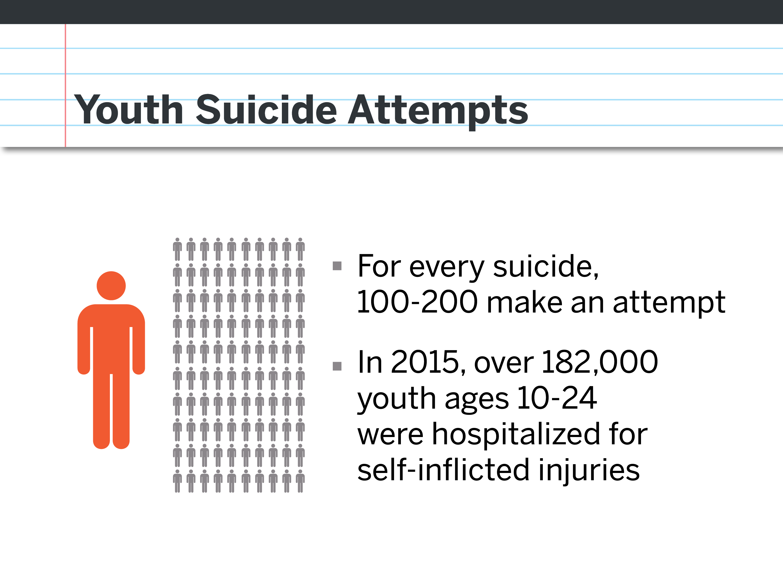
Notes:
For young people, it can be as high as 100-200 suicide attempts that require medical attention for every reported death by suicide.
For 2015 alone, there were over 182,000 young people hospitalized for self-inflicted injuries.
Youth are more likely to survive attempts because, in general:
They live with others who can rescue them
They have healthier bodies.
They have less access to lethal means.
Attempts are opportunities to intervene and help people get healthy.

Slide 10
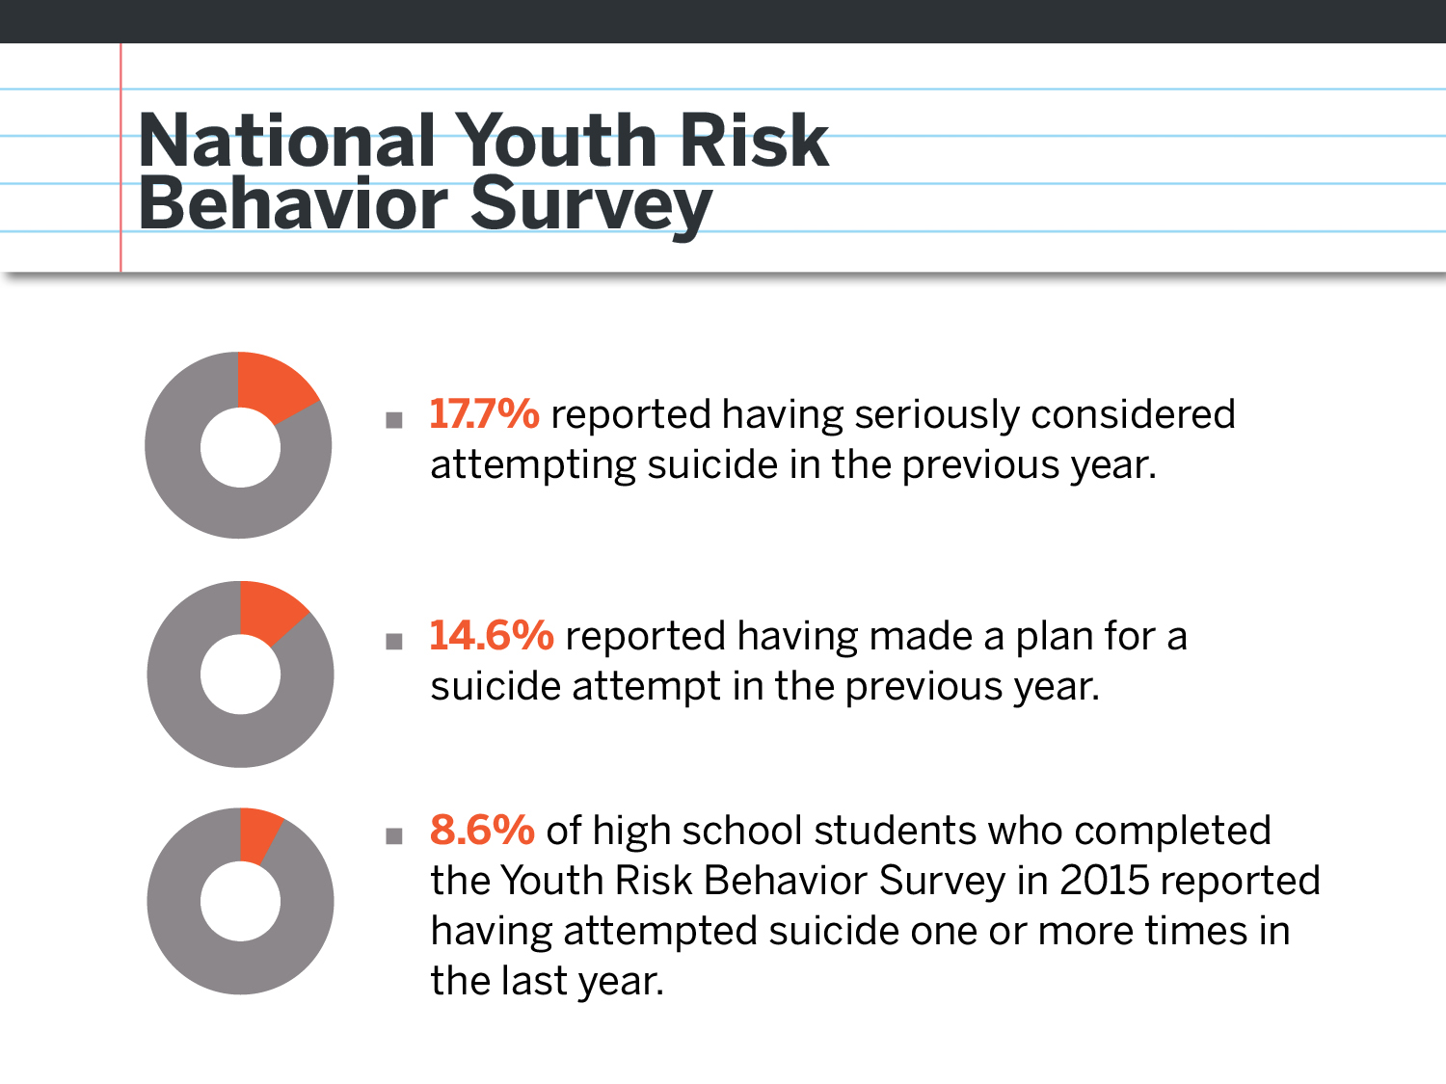
Notes:
The National Youth Risk Behavior Survey (YRBS) monitors health risk behaviors that contribute to the leading causes of death, disability, and social problems among youth and adults in the United States. It’s conducted every two years during the spring semester and provides data representative of 9th through 12th grade students in public and private schools throughout the United States.
17.7% of American High School students report that they have seriously considered attempting suicide in the past year.
14.6% have made a plan
8.6% report having made a suicide attempt in the prior year.

Slide 11
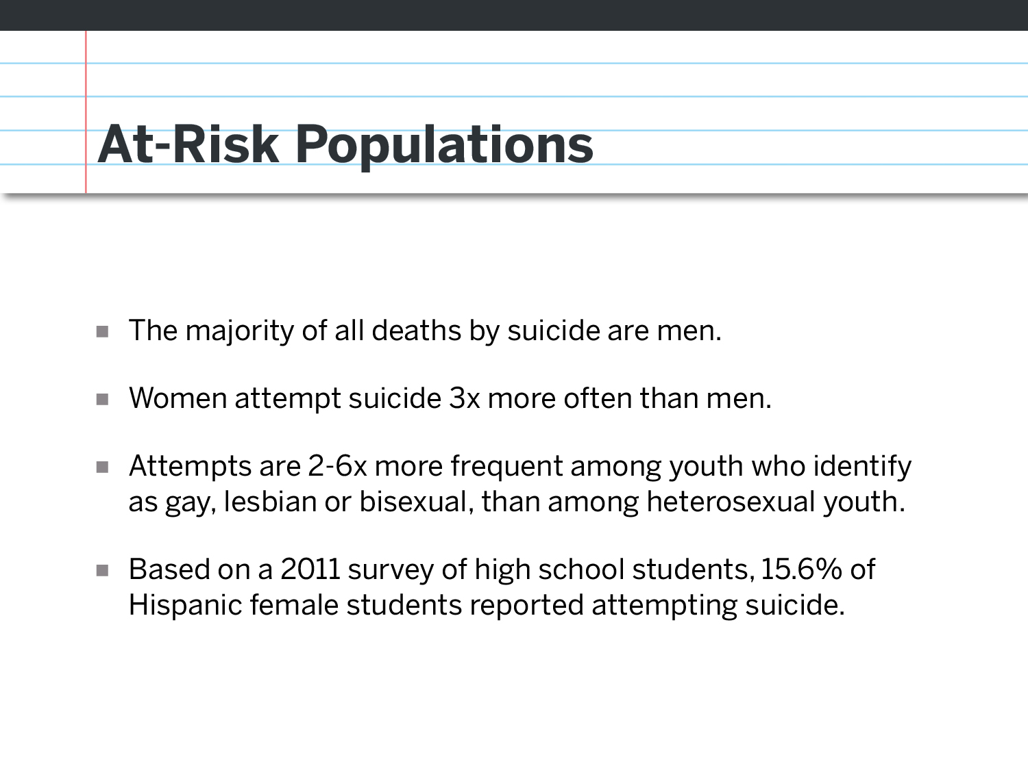
Notes:
Before we move on, it’s important to take note of a few at-risk populations:
Men die by suicide at a much higher rate than women.
However, women have been shown to make suicide attempts, and survive those attempts, at a much higher rate.
Research has shown that young people who identify as lesbian, gay or bisexual report attempting suicide 2 to 6 times more frequently.
Another population at elevated risk for suicide attempts would be Hispanic female high school students. Over 15 % reported making a suicide attempts, compared with 8% for all students.
Reference: American Association of Suicidology (AAS) 2010 & 2011 – Youth Behavior Fact Sheet

Slide 12
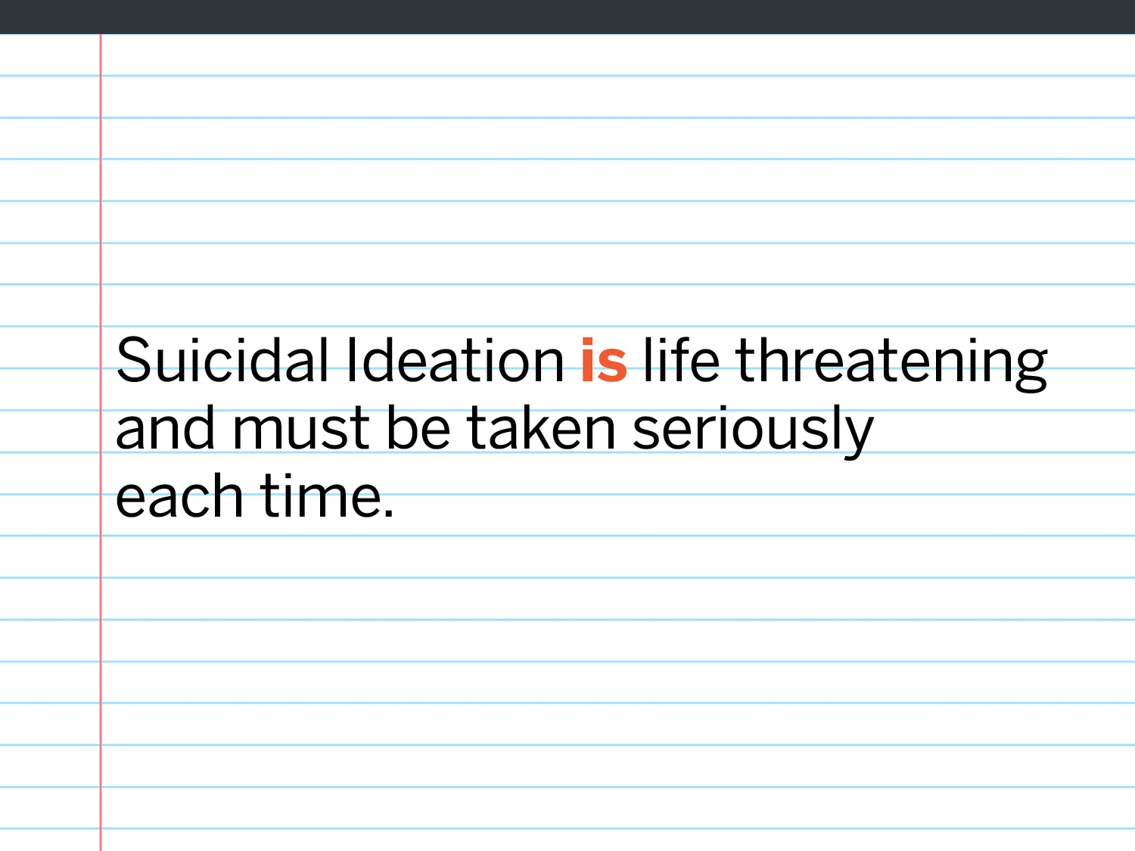
Notes:
When we hear a young person speak of wanting to take their life, or indicate that they are thinking about suicide, we must take it seriously every time.
[Facilitator’s Tip: If you forgot any of your talking points related to statistics, this is a good place to revisit and recap before moving into the next section. This is also a good place to switch trainers if you have a co-facilitator]

Slide 13
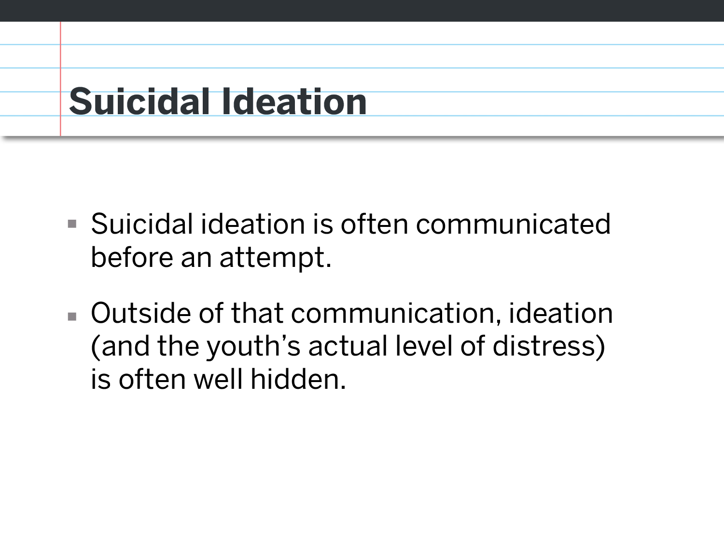
Notes:
Suicidal ideation is often communicated in the hours, weeks and months before a suicide attempt.. Outside of that communication, ideation is often well hidden.
Youth, especially young males, tend to have more difficulty communicating emotions in general,, which can be lethal when they are having thoughts of suicide.

Slide 14
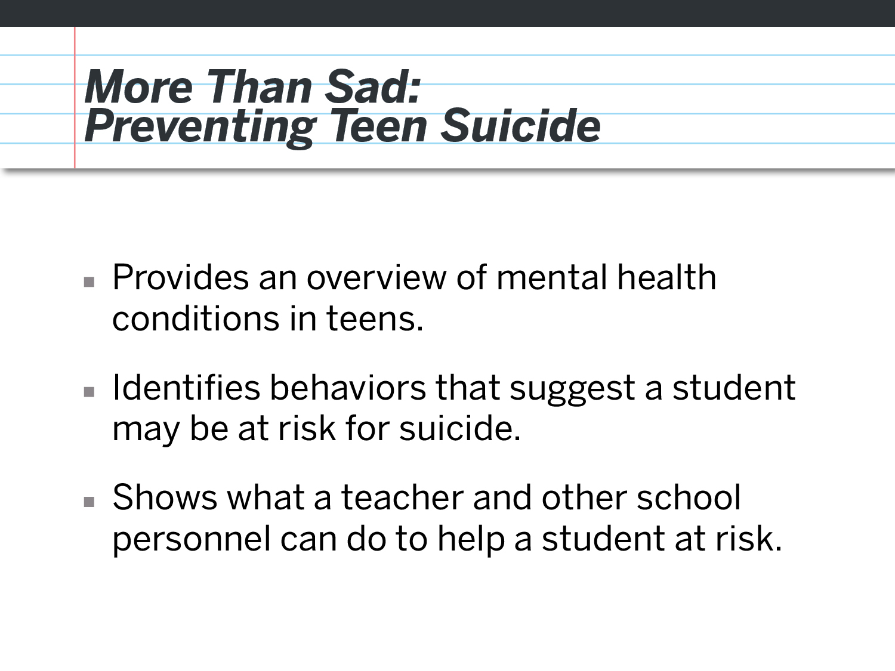
Notes:
We’re going to watch the film More Than Sad: Preventing Teen Suicide.
This film provides an overview of common mental health conditions in teens, identifies observable behaviors we can look for that might suggest that a student may be at risk for suicide, and demonstrates a few things that teachers and other school personnel can do to help a student they feel might be at risk.

Slide 15
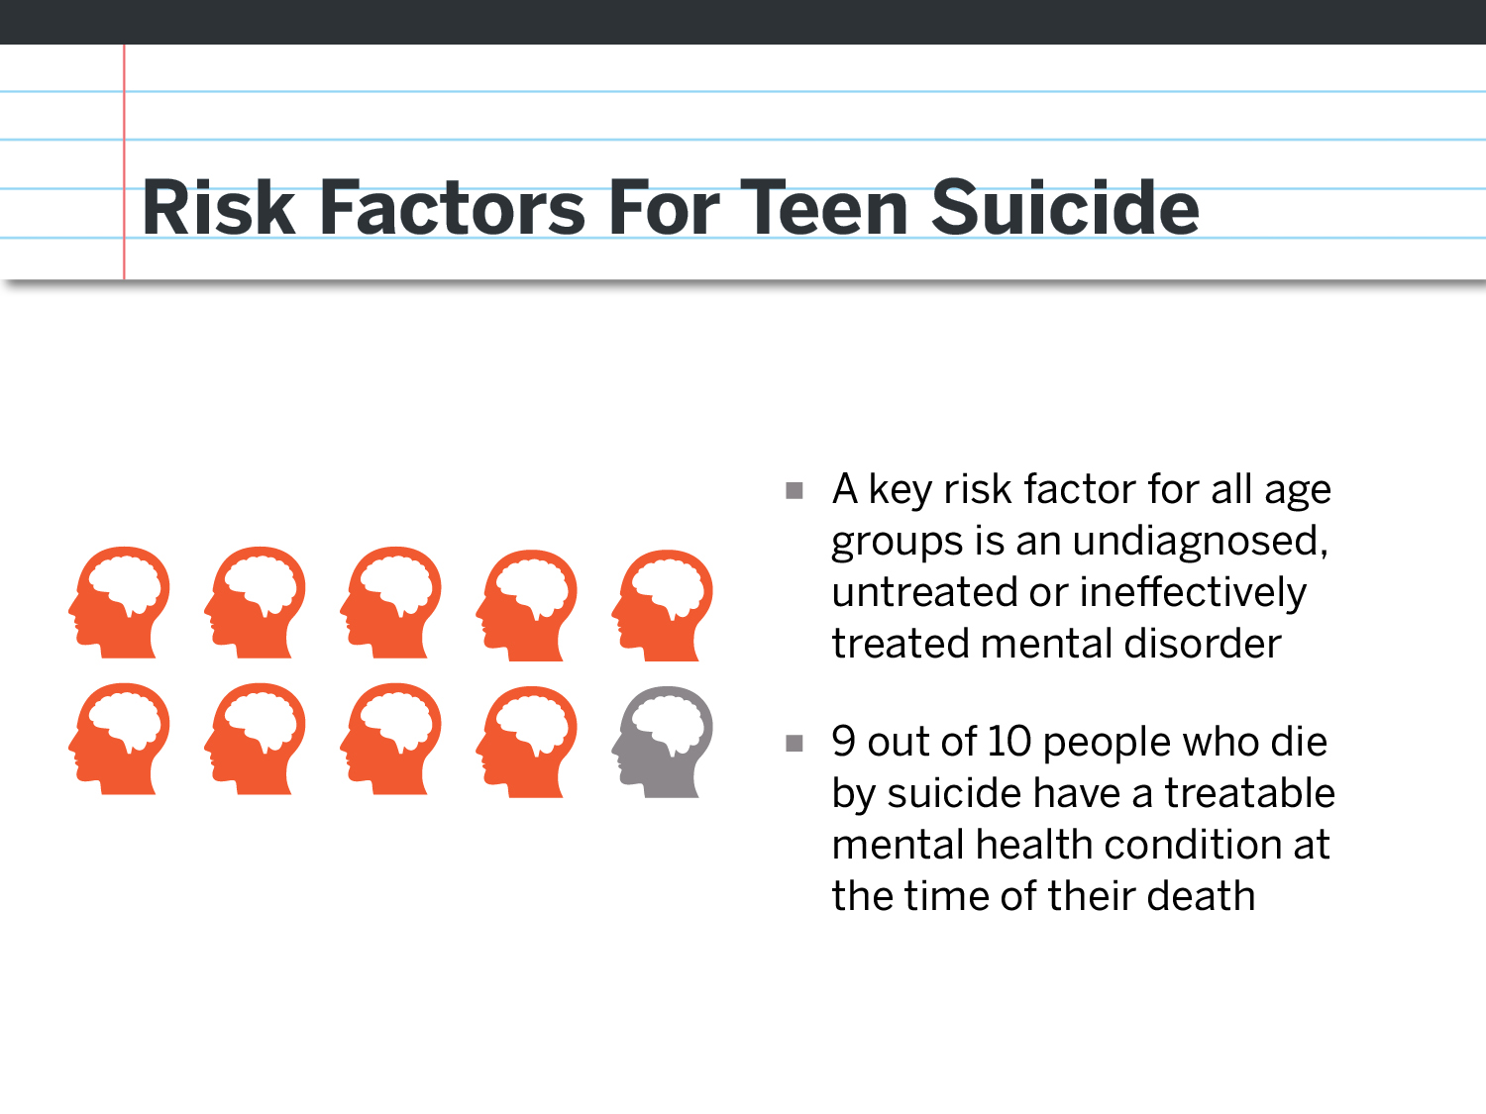
Notes:
Research has shown that more than 90% of those who die by suicide have a treatable mental health condition at the time of their death. As with other health conditions. Early identification and treatment can save lives.

Slide 16
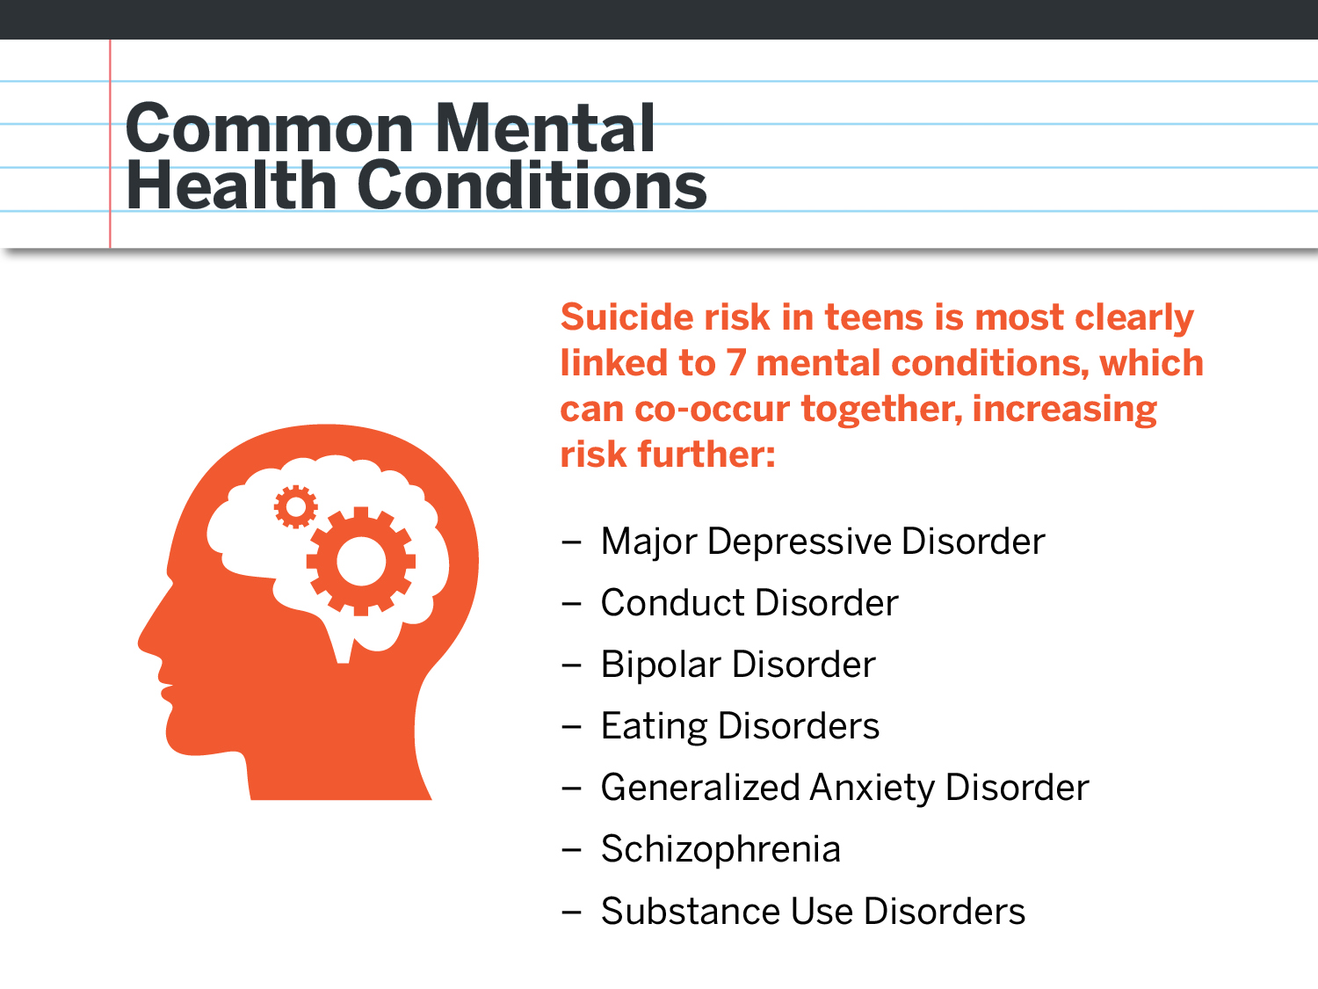
Notes:
The most common mental health conditions linked to suicide . But focusing solely on mental health conditions does not give us a full picture of the complexities of suicide risk.

Slide 17
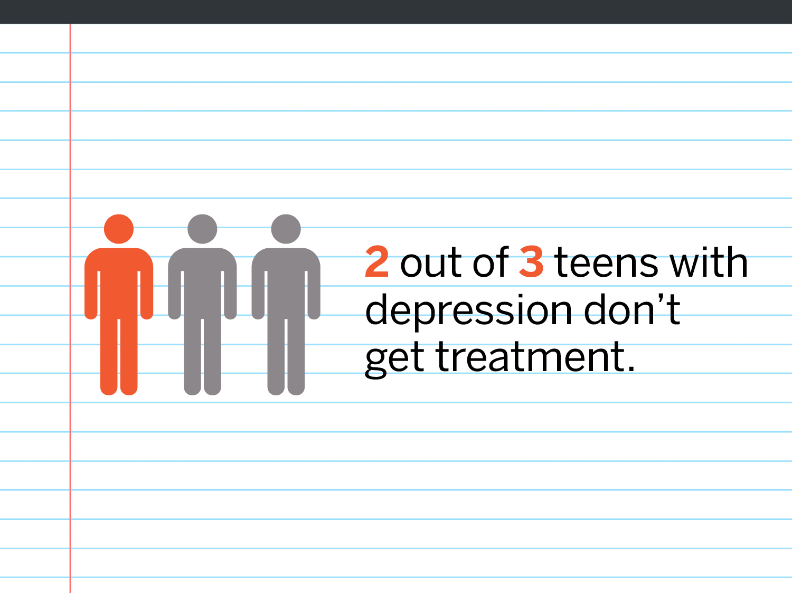
Notes:
Unfortunately, 2 out of 3 teens with depression don’t get treatment. Imagine if 2 out of 3 teens with juvenile diabetes didn’t get treatment? The outcomes can be fatal.

Slide 18
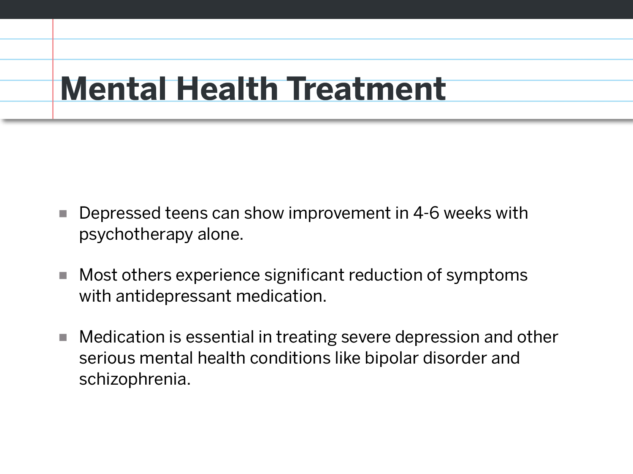
Notes:
Although treatment varies by person, condition and severity level, generally speaking, most teens who are showing signs of depression can show improvement within 4-6 weeks when receiving psychotherapy, or talk therapy.
For others, the combination of talk therapy and medication can make a significant difference.

Slide 19
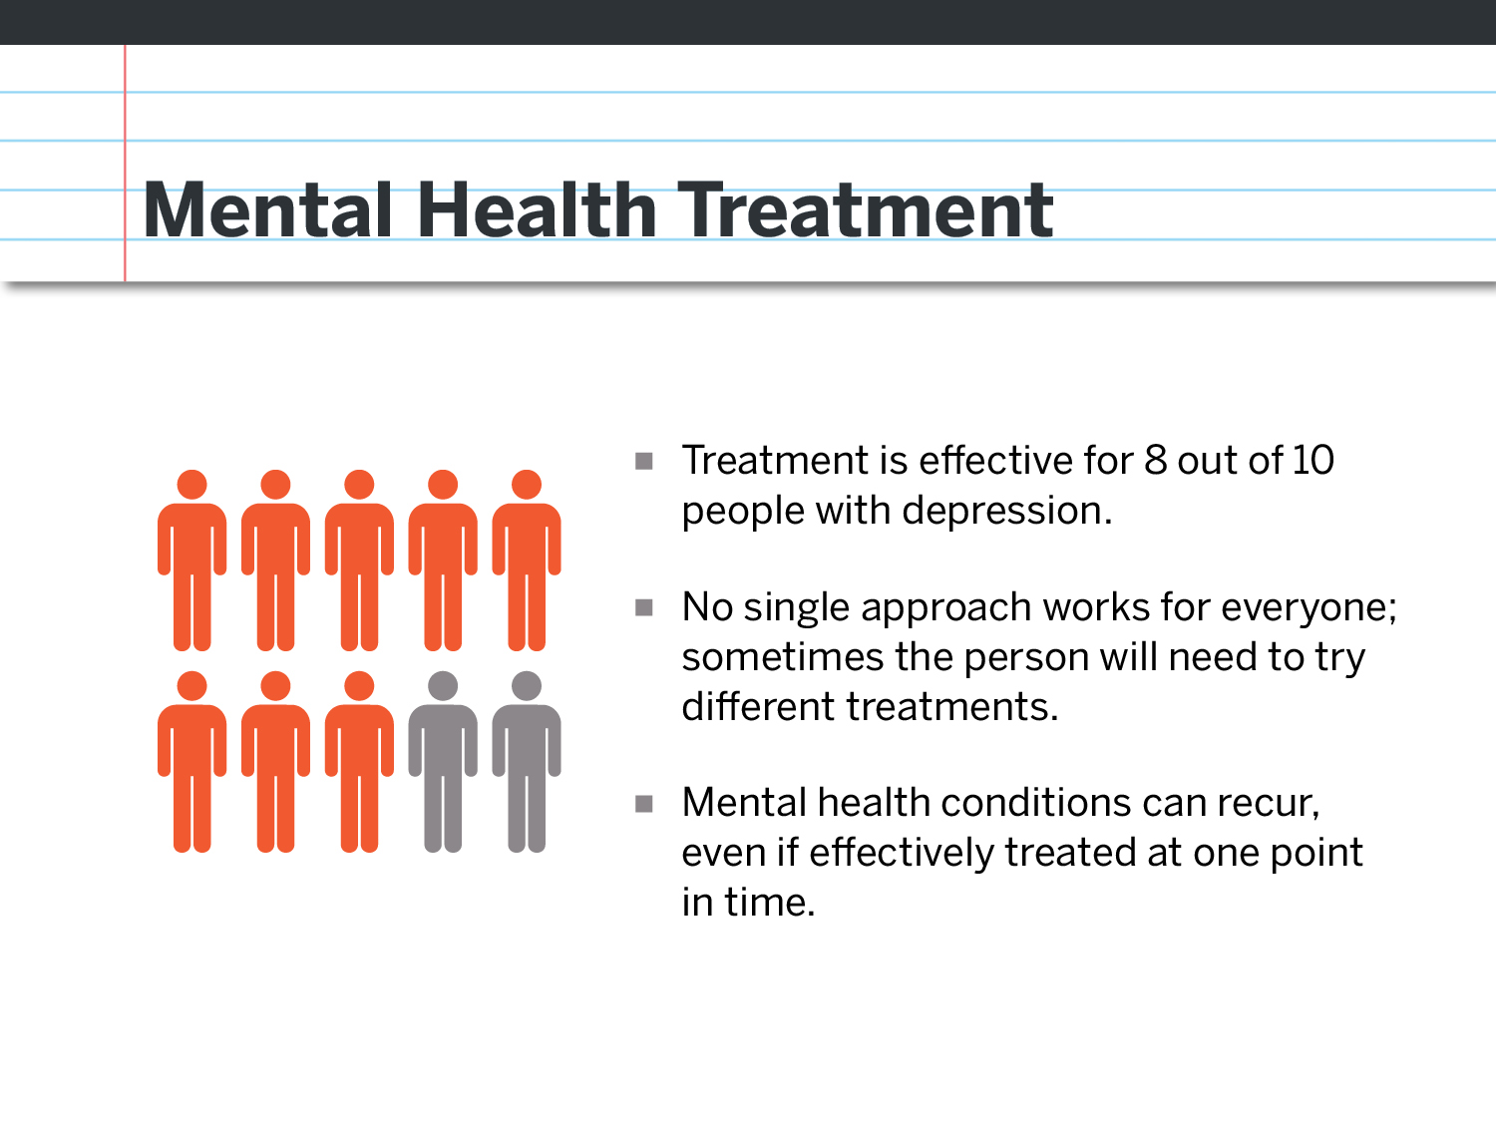
Notes:
Treatment for depression can vary both in its length and nature. For some, depression is an episode from which they will recover, though episodes can reoccur, and treatment will be in response to the symptoms during each episode. For others, depression may involve multiple episodes and will be addressed more like a chronic illness, such as diabetes. In these instances, it may be recommended that treatment continue to help prevent problems in functioning. This is why it is important to have depressive symptoms evaluated by a trained professional—so that treatment can address the core health problem as effectively as possible.

Slide 20
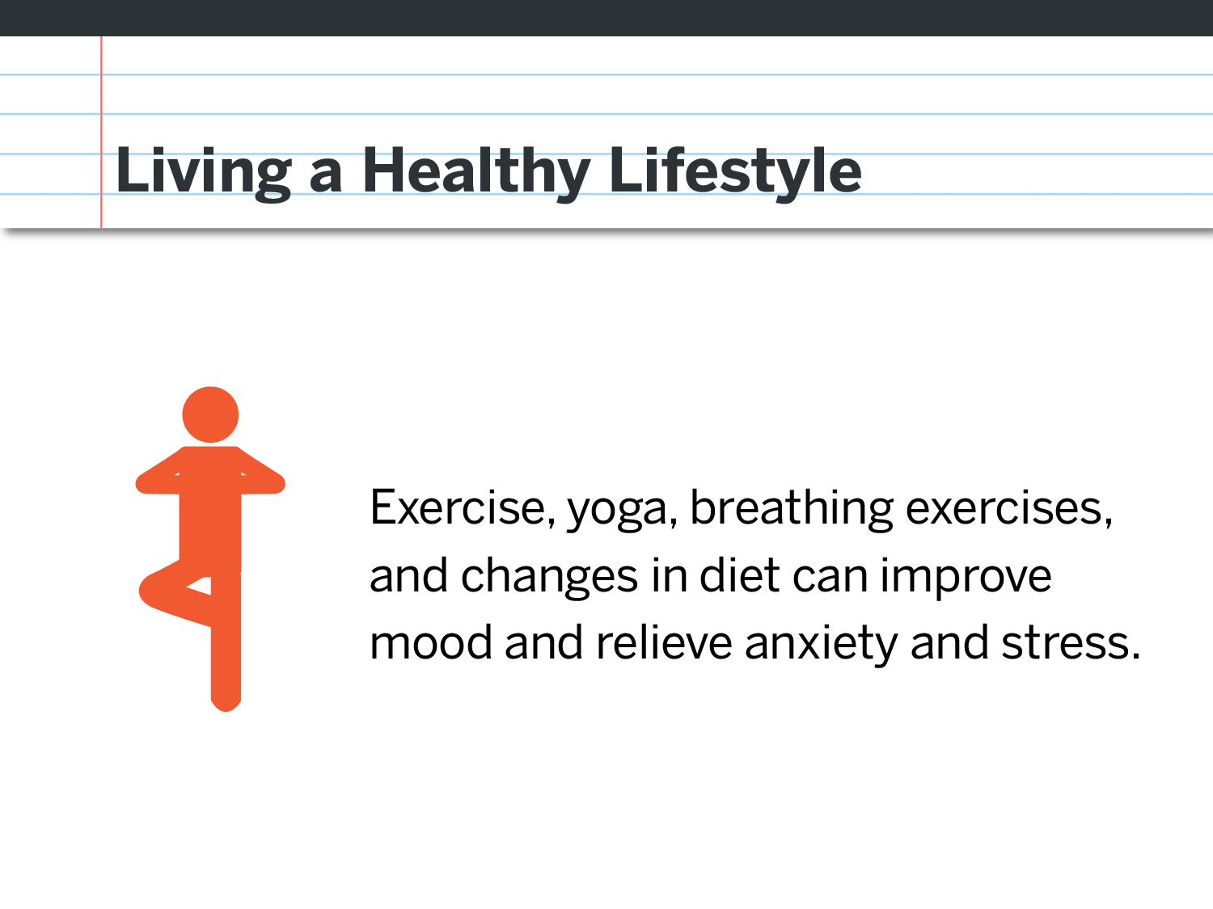
Notes:
Just like with other chronic health conditions, healthy habits can alleviate some the symptoms of a mental health condition as well.
Exercise, yoga, breathing exercises, regular sleep schedule and a healthy diet can improve moods and relieve anxiety and stress.

Slide 21
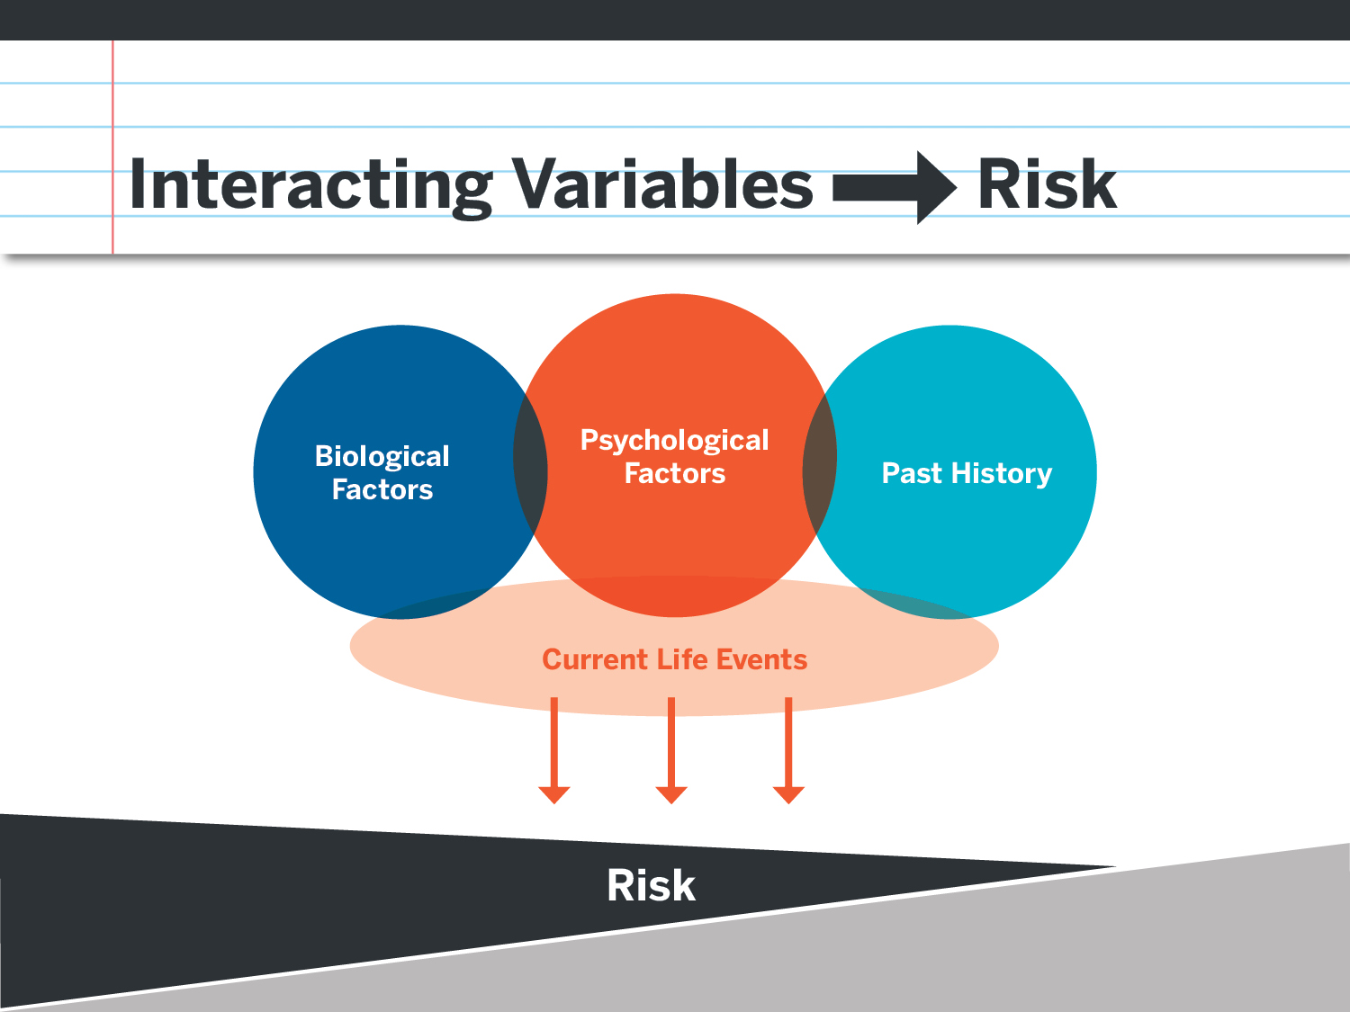
Notes:
But focusing solely on mental health conditions does not give us a full picture of the complexities of suicide risk.
Suicide risk almost always starts with the underlying layers of:
-biological factors (including genetics and biological predispositions to mental illness)
-psychological factors (such as traits like perfectionism, ways of perceiving self and interpreting events, actions of others)
-past history (death of a loved one, history of abuse, family history of health problems)
Then add the current life issues and events such as stresses at home, school and with peer relationships. These factors can come together to lead to hopelessness. Add traits of aggression, impulsivity and access to means, and you have a high risk situation.

Slide 22
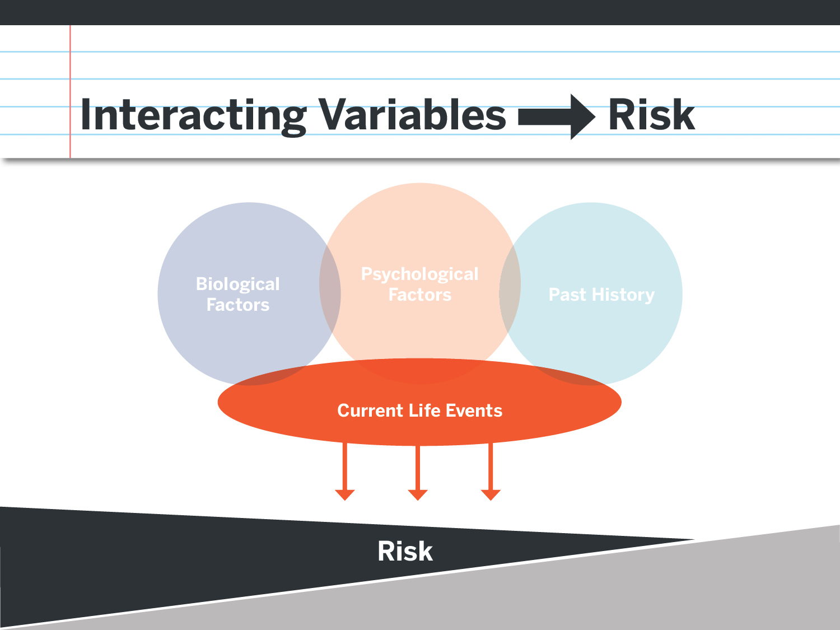
Notes:
To the outside person or to the media, it can be very difficult to even see the underlying risk factors.
But the human mind seeks answers and closure, and we think (appropriately) in terms of cause and effect.
So in most cases, a suicidal act or completed suicide is attributed primarily to external factors with only glimpses of the more invisible but critical issues.

Slide 23
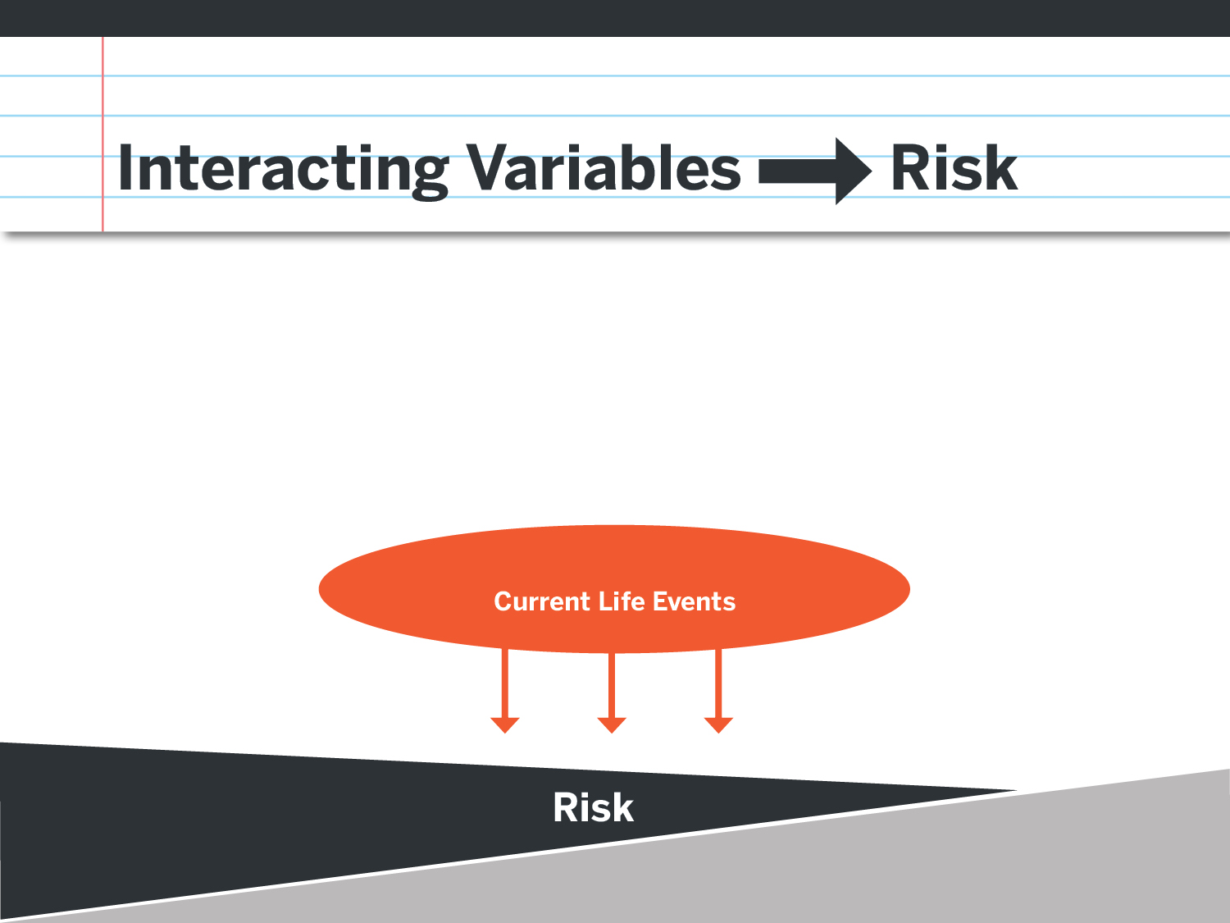
Notes:
Anguish and despair are extremely private, internal experiences. What gets expressed outwardly is highly variable, with some individuals wearing their emotions on their sleeve, and others keeping emotions fairly hidden from view. This is the reason paying attention to even subtle but distinct behavioral changes that represent a departure from the person’s “usual self” is part of the education involved in suicide prevention.
And this is a way to understand the common misunderstanding about suicide being caused by a single event or loss, or the main focus being on external events.

Slide 24
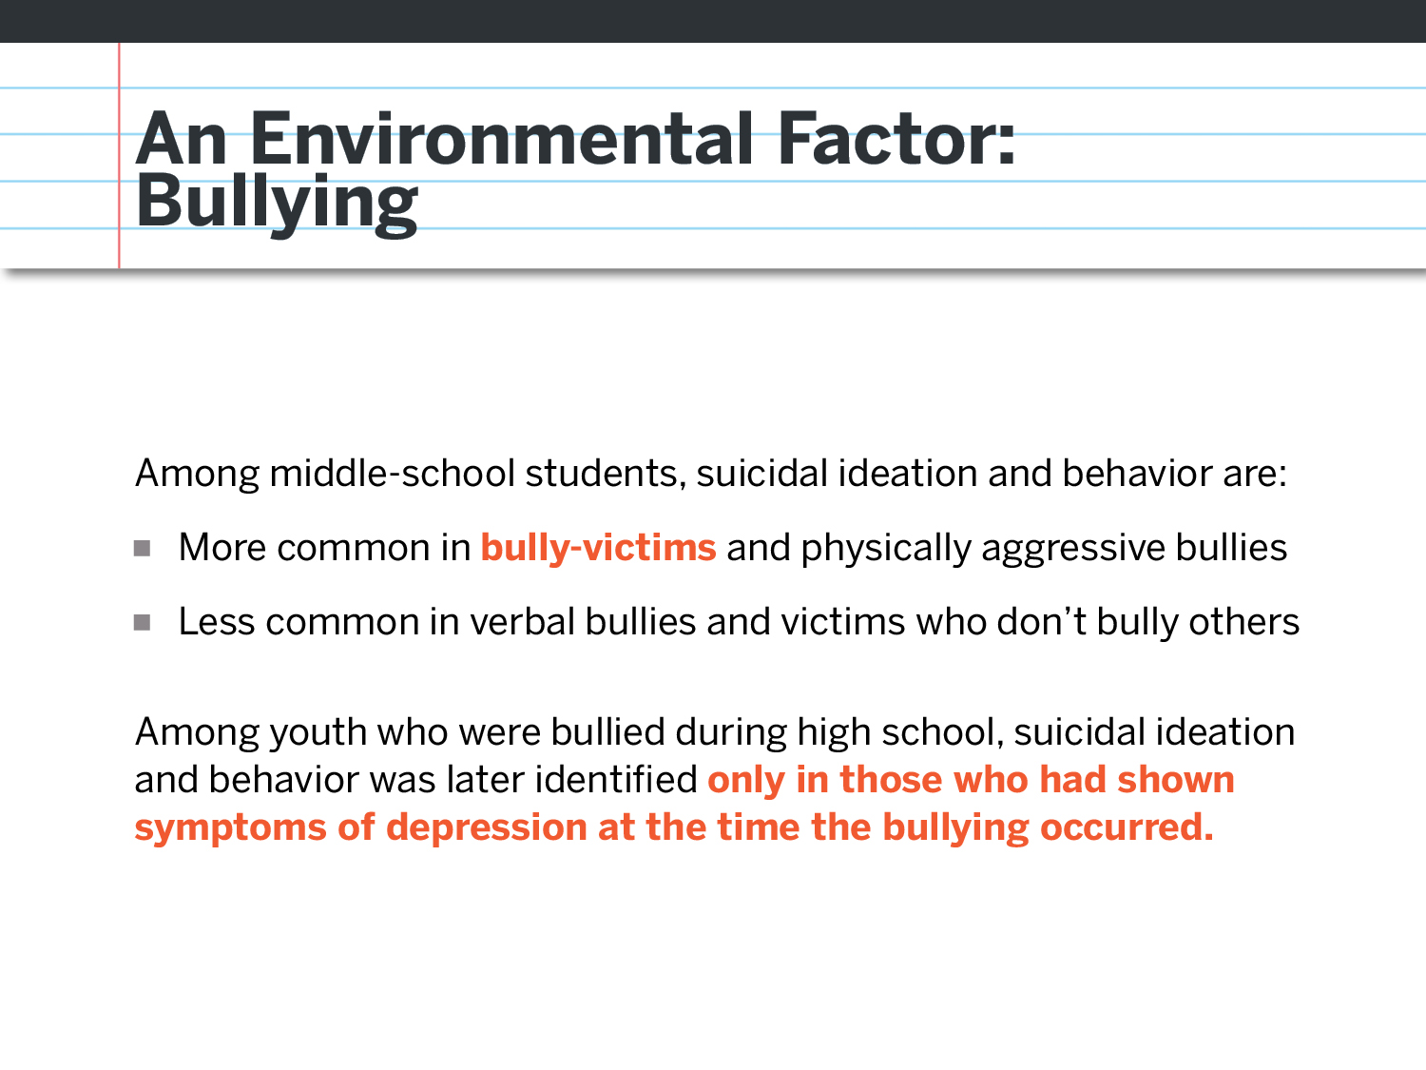
Notes:
One environmental risk factor for suicide among youth that has gotten press coverage is bullying. However, in shining a spotlight on the role that bullying possibly played in the death of a child, we overlook the students at greatest risk for suicide. Recent studies have shown that individuals who are both the bully and the victim are at greater risk that those who are the victim alone.
Studies have also found that among individuals who were bullied, only those exhibiting signs of depression or other mental health conditions also has thoughts of suicide. (Klomek et al., 2011)
Facilitator’s Tip: For more information on the link between bullying and suicide, please download the CDC’s publication: The Relationship Between Bullying and Suicide: What we Know and What it Means for Schools. http://www.cdc.gov/violenceprevention/pdf/bullying-suicide-translation-final-a.pdf
If you know that this will be a major topic of discussion at a particular school, please print a few copies of this document to have on hand.

Slide 25
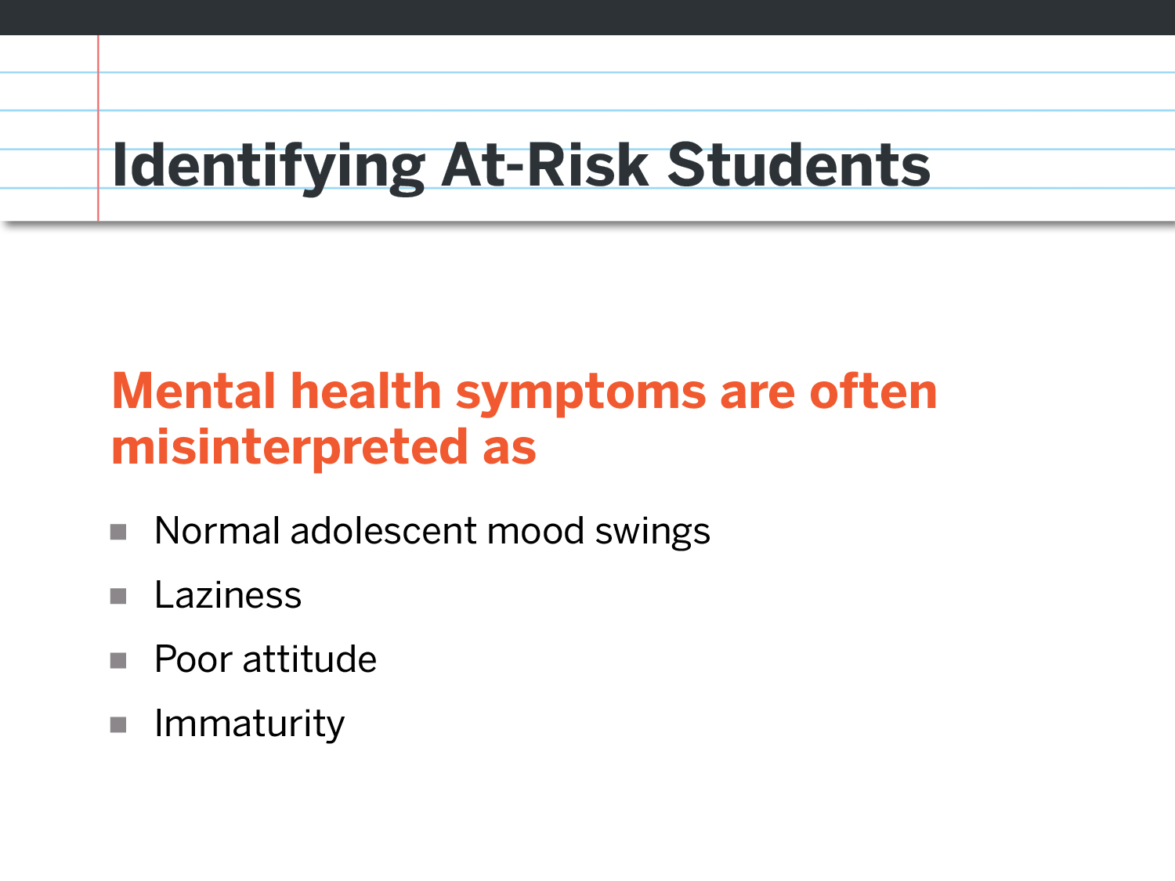
Notes:
It’s not always easy to identify students who are at risk for suicide, because common symptoms for many mental health conditions are often misinterpreted as:
Normal adolescent mood swings
Laziness
Poor or Bad Attitude
Immaturity

Slide 26
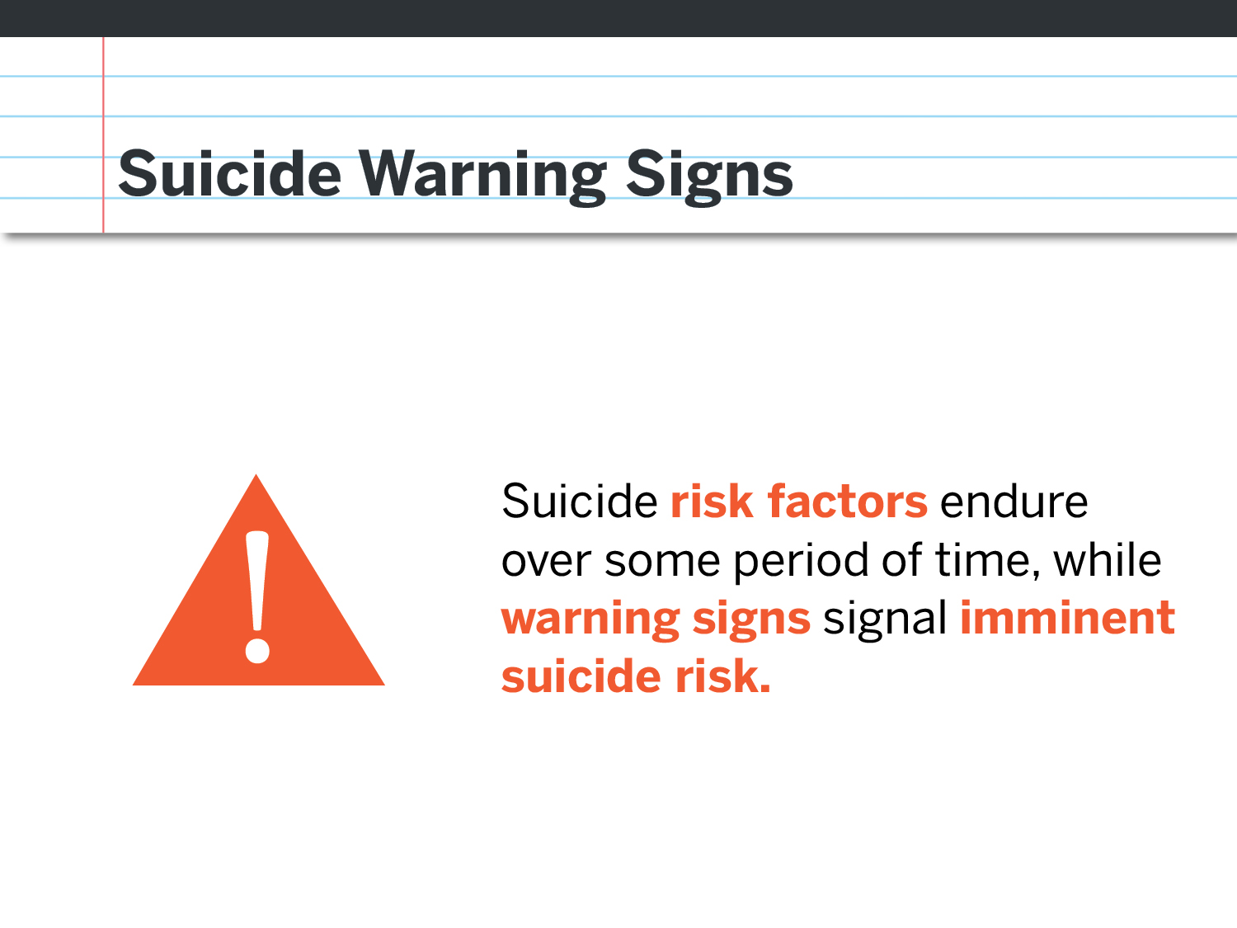
Notes:
Risk factors can be subtle to detect, and having lots of risk factors doesn’t necessarily mean that someone is having thoughts of suicide. For example, high cholesterol and heart disease may run in your family, yet that does not mean that you have heart disease or that you are currently having a heart attack. Risk factors are longer term issues that signal the need to be as proactive as possible when it comes to mental health.
Warning signs are observable signs that someone may be at imminent risk for attempting suicide.

Slide 27
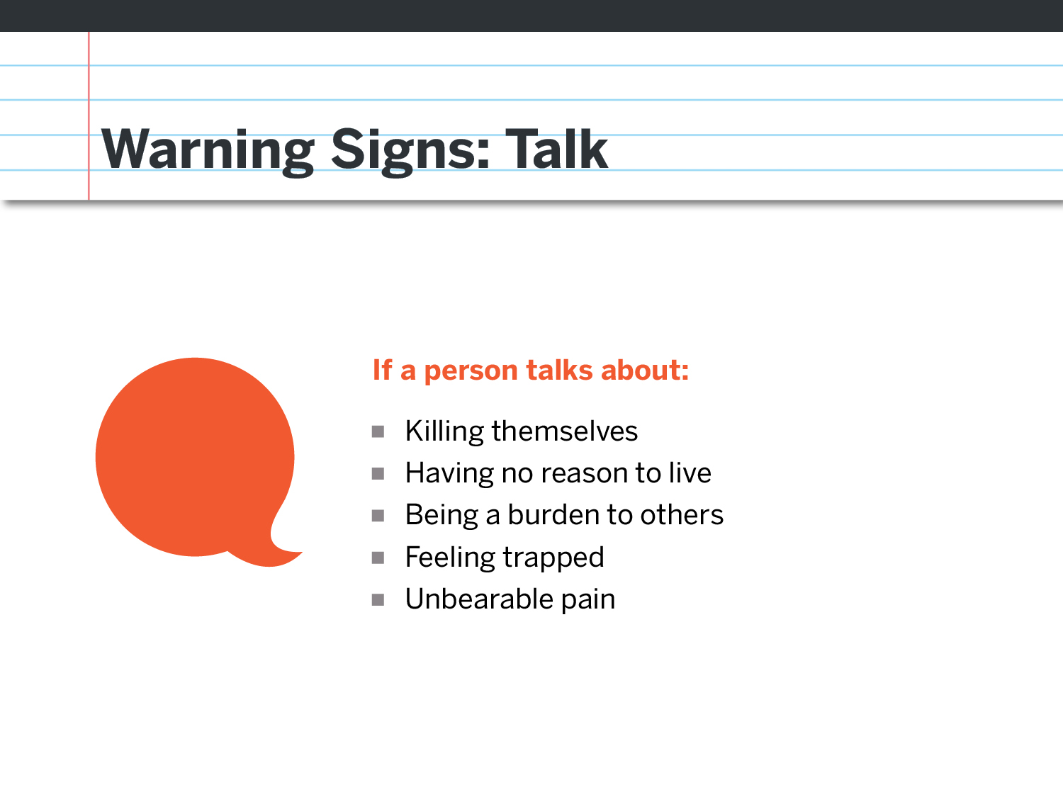
Notes:
Sometimes we will hear the warning signs in what is being said.
We want to listen for statements such as:
“I should just kill myself”
“I’ve got no reason to live”
“Everyone would be better off without me”
“there’s no way out of this”
“I can’t live like this anymore”
“I can’t take this pain anymore”
Don’t assume they’re joking. Always start the conversation.

Slide 28
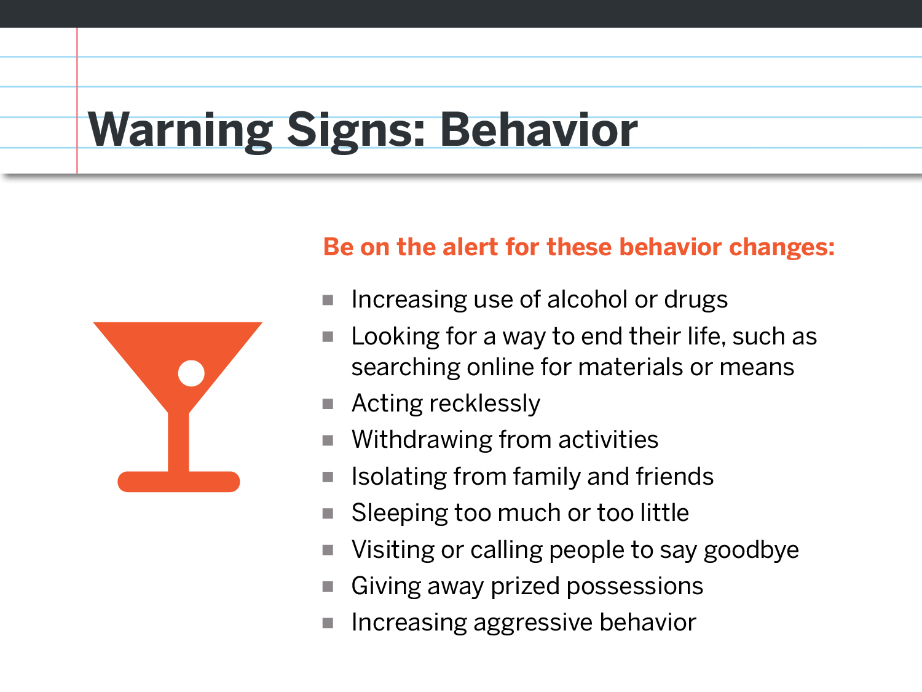
Notes:
A person’s suicide risk is greater if a behavior is new or has increased, especially if it’s related to a painful event, loss, or change.
We want to look for:
-Increased alcohol or drug use
-Google searches for suicide methods
-Acting recklessly such as driving too fast, risky sexual behaviors, etc.
-Withdrawing from usual activities
-Isolating from family and friends, such as going silent on social media
-Individuals in distress can develop insomnia or can actually sleep more, appearing to hibernate. A sudden change in either direction is something to take notice of.
-Saying goodbye or giving away prized possessions is also a behavior we do not want to ignore.
-Increased aggression & picking fights is another warning sign that is often missed. If you have a teen who is normally easy going and peaceful and all the sudden becomes aggressive and violent, it’s time to take notice.

Slide 29
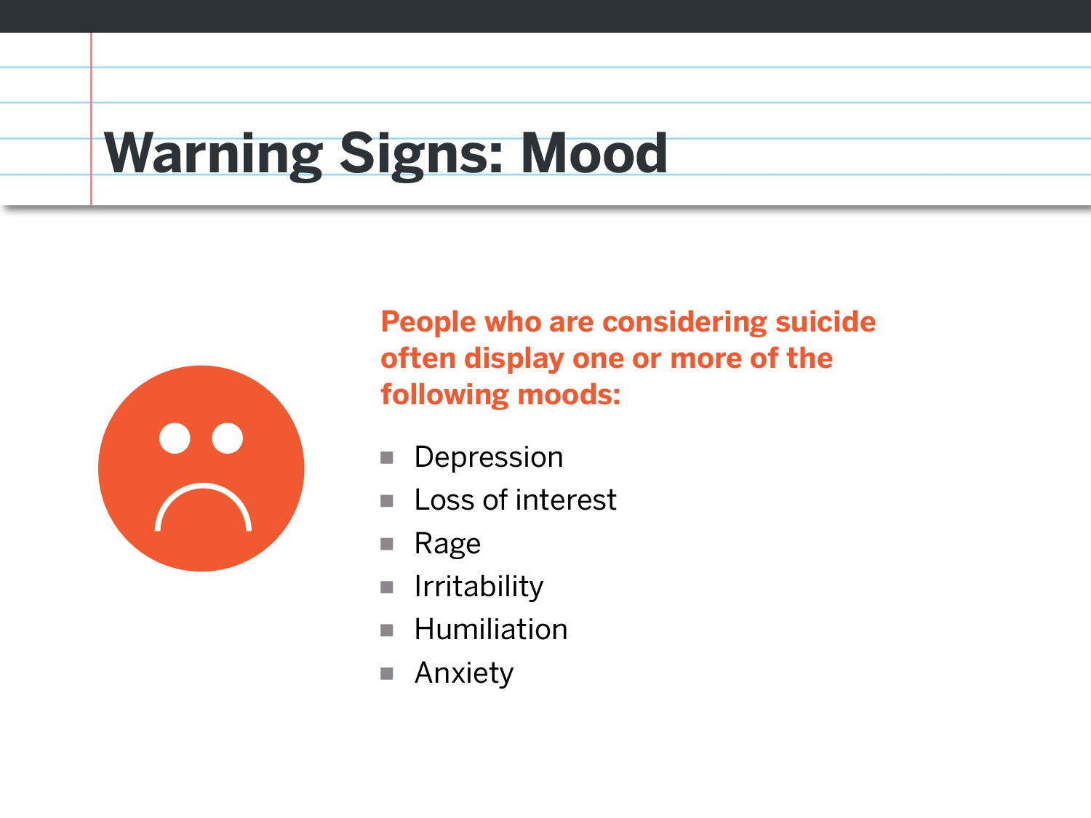
Notes:
Sometimes our best indication that someone could be at risk for suicide is a sudden change in their mood. In the film, remember the teacher who made notes in his attendance list of his students’ moods?
We want to watch for depression, lethargy, loss of interest, rage, increased irritability, shame, humiliation or extreme embarrassment, and anxiety.
When we’re seeing these warning signs in our students, it’s time to start a conversation.

Slide 30
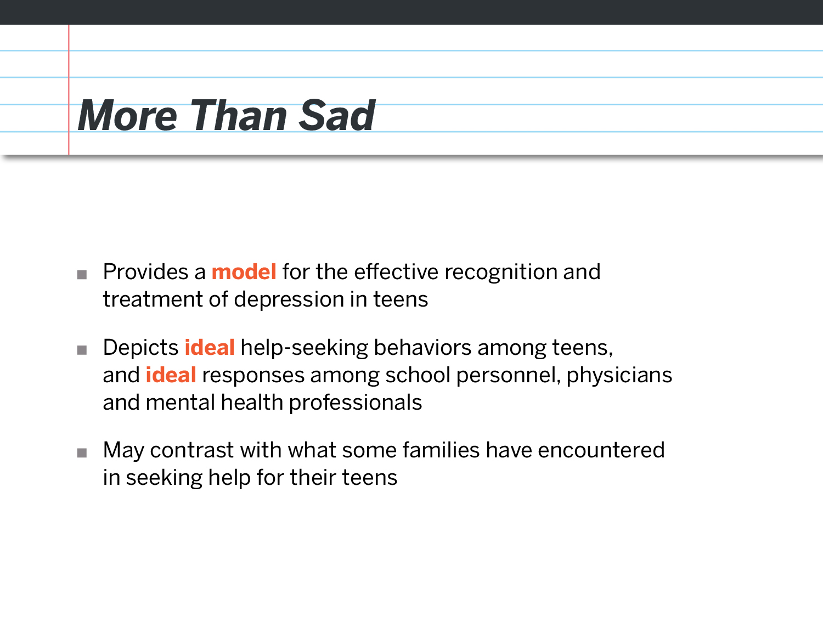
Notes:
In a moment, we will watch a second film: More Than Sad – Teen Depression
What you will see in this 25 minute film is ideal help-seeking behaviors among teens, as well as ideal responses on the part of school personnel, physicians and mental health professionals. Of course, these are best case scenarios and may differ quite a bit from what some families have actually experienced when seeking helps for their teens.
When shown to high school students, this film has been shown to be extremely effective at improving a students’ willingness to seek help for themselves and for their friends.
Facilitator’s tip: If you are also planning to show this film to their teens, or have already done so, mention that here.
Start film: film will run for approximately 25 minutes.

Slide 31
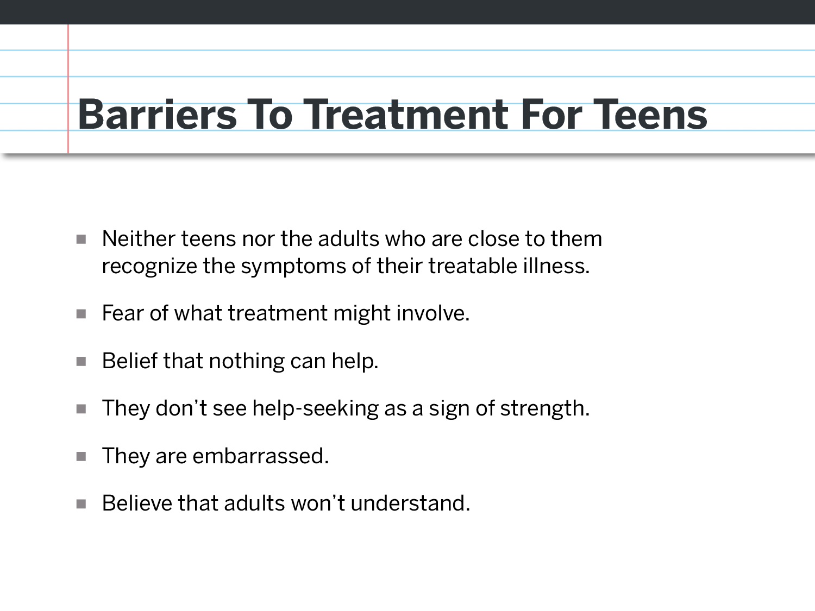
Notes:
As we discussed earlier, although treatment is effective most in most cases, these common barriers get in the way, leading to only 1/3 of teens experiencing a mental health crisis to get the help they need.
Sometimes the symptoms aren’t recognized as signs of a possible health condition and are dismissed, even by the person experiencing them
Fear of what treatment may involve can also keep those who are struggling from reaching out for help
An overall sense of helplessness or hopelessness, both symptoms of depression, can lead someone at risk to not reach out for help. We saw this with Lana in the film.
When helpseeking is not seen as a sign of strength, those who are struggling often don’t reach out for help. We can create a culture within our schools, and in society in general, that makes reaching out for help socially acceptable.
When helpseeking is seen as weakness, mental health conditions are mocked or demonized in the media, or in Delia’s situation, teens at risk are simply too embarrassed to reach out for help.
And of course, teens generally believe that adults won’t understand, so they don’t reach out.

Slide 32
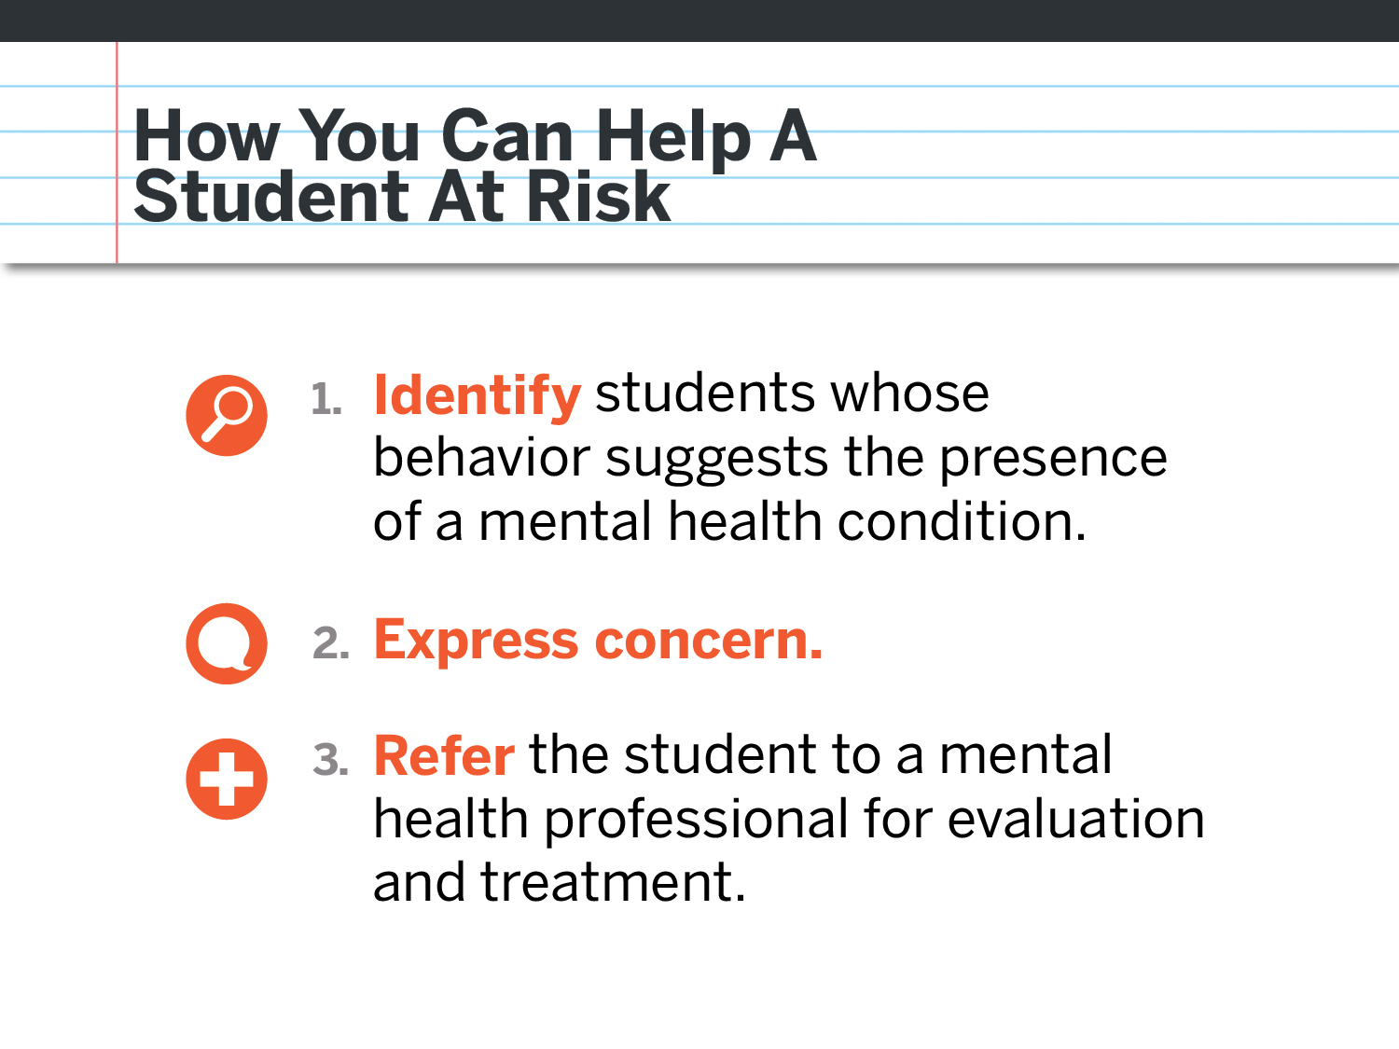
Notes:
In the school setting, you can play a powerful role in helping students at risk through these 3 basic steps.
When you identify students who are displaying some of the warning signs that we mentioned, or that you just feel in your gut are in distress, show that you care. Express your concern to the student, and make the referral to your school counselor or school based mental health professional

Slide 33
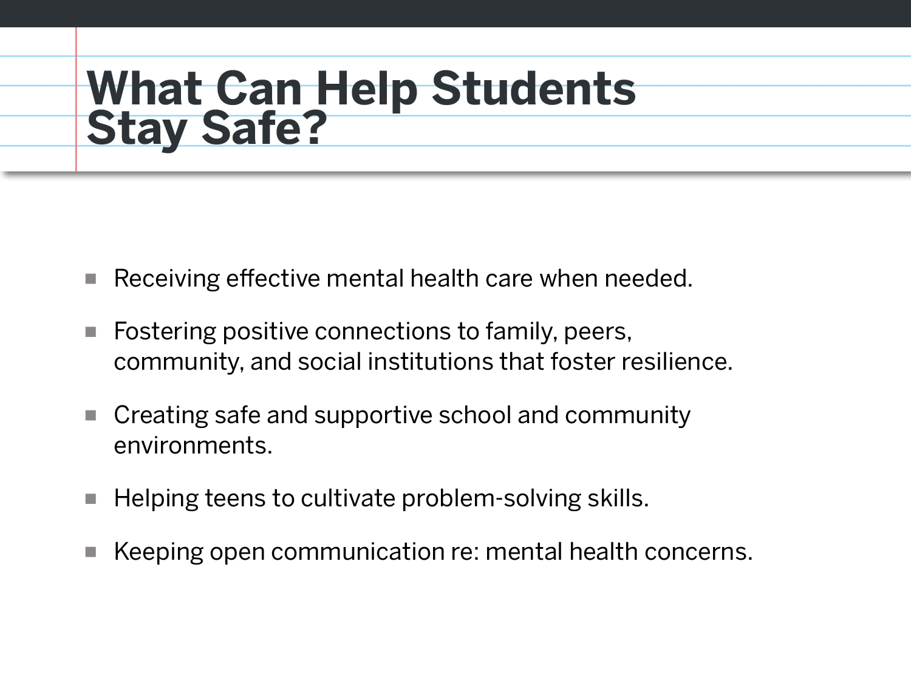
Notes:
Protective factors are not just the opposite or lack of risk factors. Rather, they are conditions that promote strength and resilience and ensure that vulnerable individuals are supported and connected with others during difficult times, which make suicidal behaviors less likely. (from the National Strategy 2012)

Slide 34
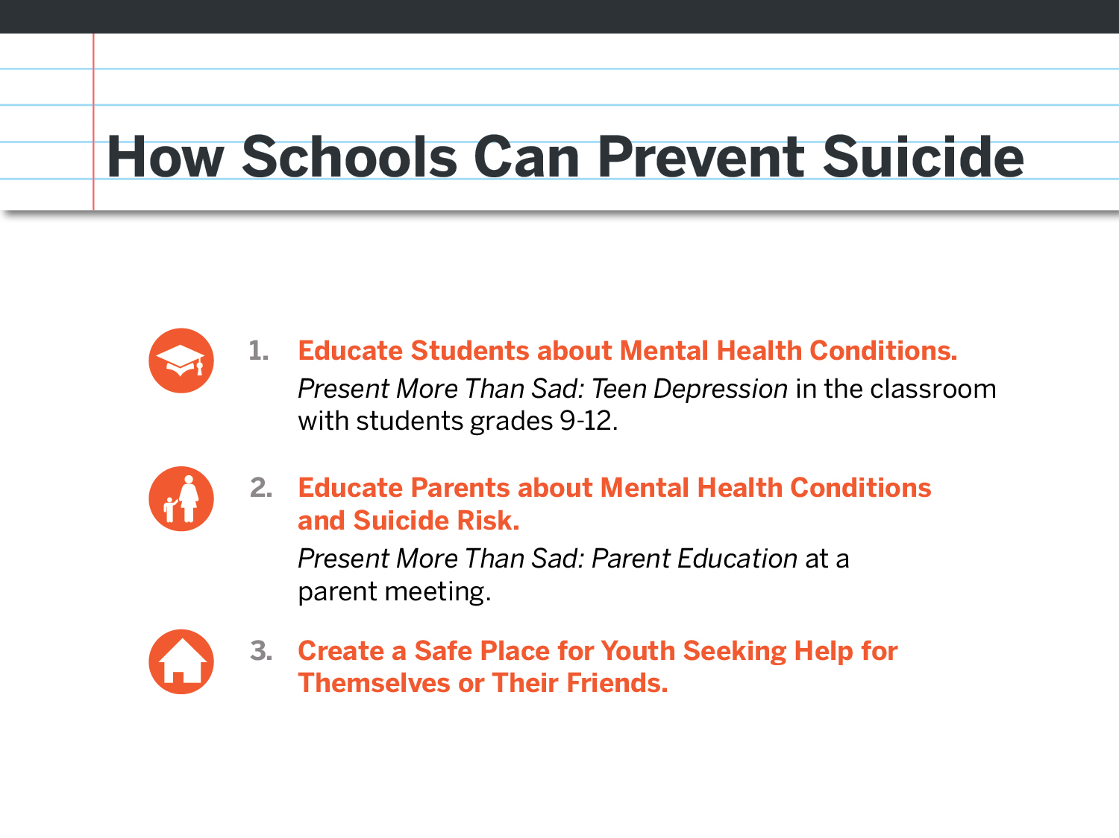
Notes:
Now that the faculty and staff have been trained, there are other steps your school can take to prevent suicide.
The second film from today’s presentation can be shown to students grades 9-12 in a classroom setting. Facilitator tools are available online. After watching this film, nearly 94% of students said they would be more likely to reach out for help for a friend they felt was at risk.
Online you can also find the facilitator tools needed to make a presentation at a parents’ meeting.
Helping to foster a healthy supportive school community creates protective factors that help everyone, and for those who are at risk for suicide it can save their lives.

Slide 35
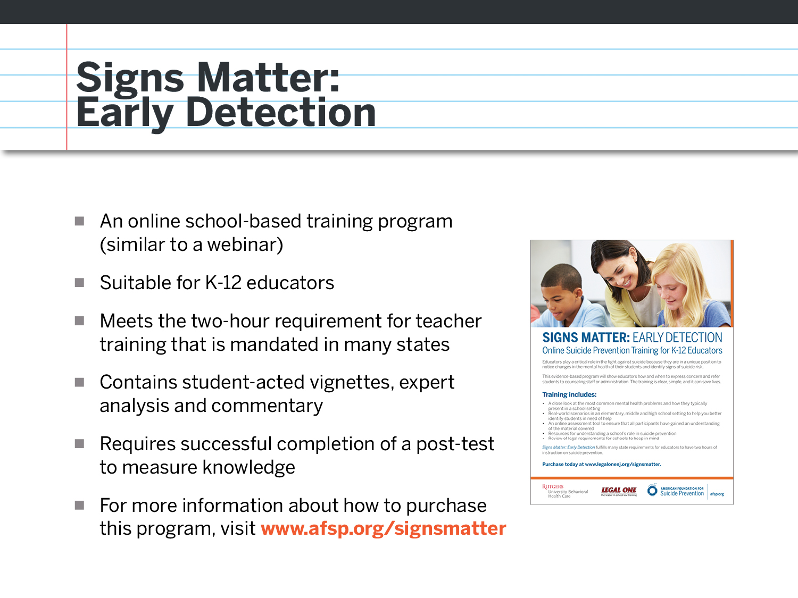
Notes:
This is online suicide prevention teacher education program that was developed in partnership with Rutgers University Behavioral Health and Legal One.

Slide 36
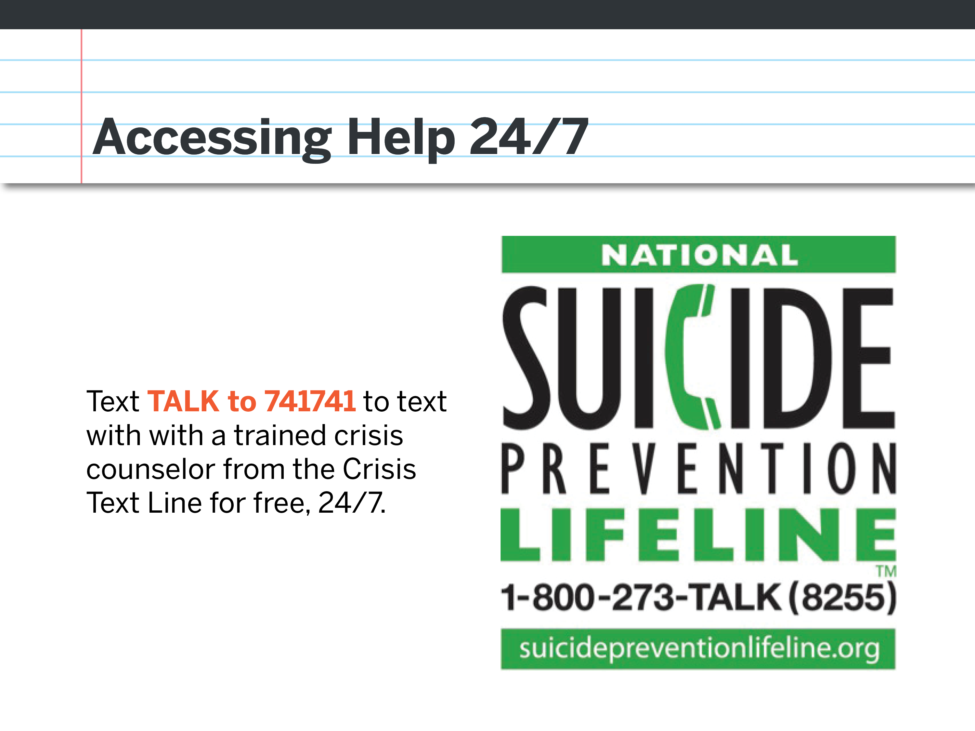
Notes:
If you or someone that your concerned about is in crisis, the National Suicide Prevention Lifeline is always available. By saving this number in your phone, help will always be at your fingertips. Everyone take out your smart phones now. Save this number as a contact.
Online crisis chat is also available at www.crisischat.org

